Slide 1
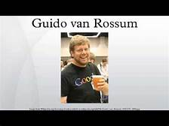
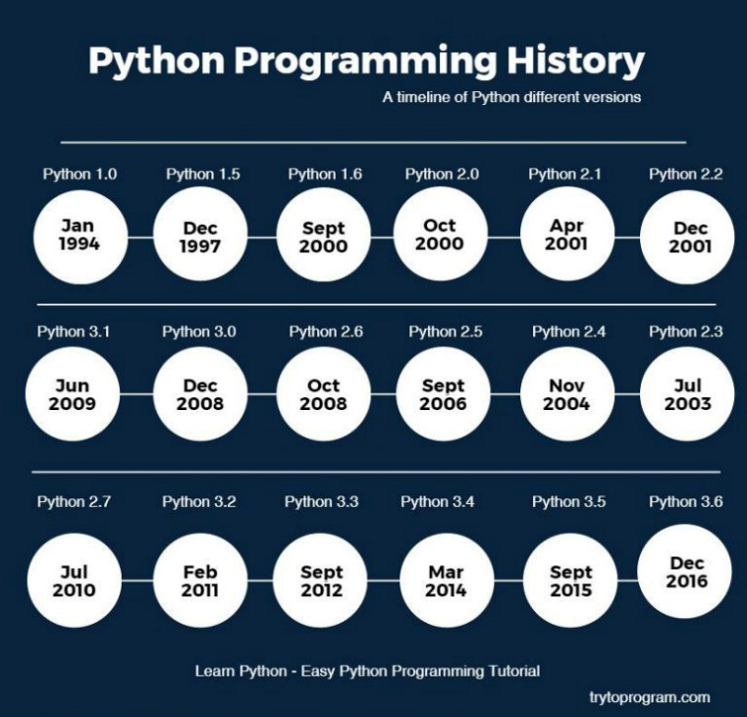
Python is an object-oriented and open-source language developed in the 1980s by Dutchman Guido van Rossum.
Story Behind the name : Back in the 1970s, there was a popular BBC comedy tv show called Monty Python’s Fly Circus and Van Rossum happened to be the big fan of that show.
First version : Python 0.9.0 (Feb 1991)

Slide 2
What can Python do?
Python can be used on a server to create web applications.
Python can be used alongside software to create workflows.
Python can connect to database systems. It can also read and modify files.
Python can be used to handle big data and perform complex mathematics.
Python can be used for rapid prototyping, or for production-ready software development.

Slide 3
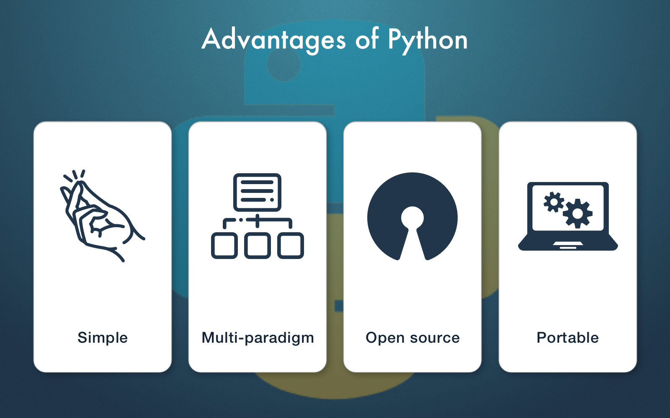
Advantages of Python
Python is Interpreted − Python is processed at runtime by the interpreter. You do not need to compile your program before executing it.
Python is Interactive − You can actually sit at a Python prompt and interact with the interpreter directly to write your programs.
Python is Object-Oriented − Python supports Object-Oriented style or technique of programming that encapsulates code within objects.
Python is a Beginner's Language − Python is a great language for the beginner-level programmers and supports the development of a wide range of applications from simple text processing to WWW browsers to games.

Slide 4
Program Development Life Cycle(PDLC)
PDLC: It is a tool to guide the programmers (or) to develop a program to solve a problem.
It has different steps:
1. Problem Analysis
2. Program Modelling
3. Coding Program
4. Testing and Debugging
5. Maintenance
Steps in PDLC
Analysis
Modelling
Coding
Testing & Debugging
Maintenance

Slide 5
INPUT,PROCESSING AND OUTPUT
Input: It is captures the data from user, or it is the process of accepting data or information, by using input the computer can do any process
Process: It is the process to convert the input into output.
Output: It is the display or output of result from processing.
Input
Data
Processing
Information
Output
Take food order
Add up the separate items
Produce the bill

Slide 6
Displaying output with the print() function
The simplest way to produce output is using the print() function where you can pass zero or more expressions separated by commas. This function converts the expressions you pass into a string before writing to the screen.
The full syntax of print() is:
print(*objects, sep=' ', end='\n', file=sys.stdout, flush=False)
print() Parameters:
objects - object to the printed. * indicates that there may be more than one object
sep - objects are separated by sep. Default value: ' '
end - end is printed at last
file - must be an object with write(string) method. If omitted it, sys.stdout will be used which prints objects on the screen.
flush - If True, the stream is forcibly flushed. Default value: False

Slide 7
How print() works in Python?
Example 1:
print("Python is fun.")
a = 5
# Two objects are passed
print("a =", a)
b = a
# Three objects are passed
print('a =', a, '= b')
Output:
Python is fun.
a = 5
a = 5 = b

Slide 8
How print() works in Python?
Example 2:
print() with separator and end parameters:
a = 5
print("a =", a, sep='00000', end='\n\n\n')
print("a =", a, sep='0', end='')
Output:
a =000005
a =05

Slide 9
How print() works in Python?
Example 3:
print() with file parameter:
sourceFile = open('python.txt', 'w')
print('Pretty cool, huh!', file = sourceFile)
sourceFile.close()
This program tries to open the python.txt in writing mode. If this file doesn't exist, python.txt file is created and opened in writing mode.
Here, we have passed sourceFile file object to the file parameter. The string object 'Pretty cool, huh!' is printed to python.txt file (check it in your system).
Finally, the file is closed using close() method.

Slide 10

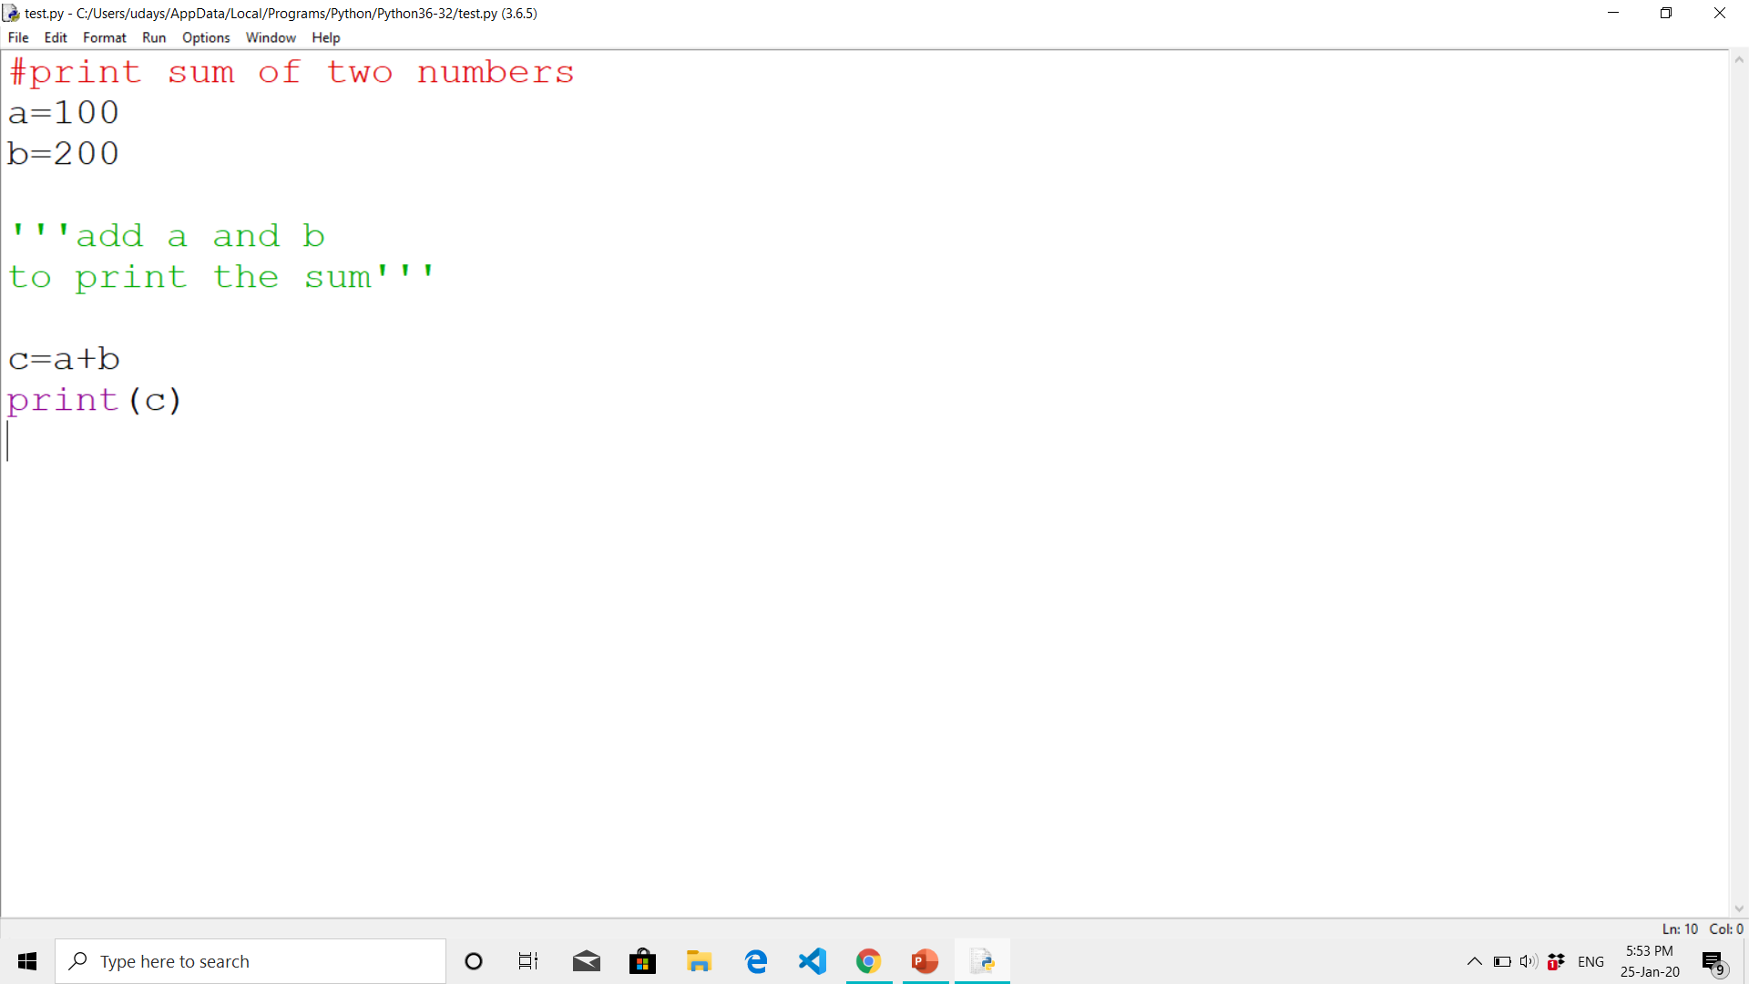
COMMENTS
Comments: Comments are very important while writing a program. They describe what is going on inside a program, so that a person looking at the source code does not have a hard time figuring it out.
In Python, we use the hash (#) symbol to start writing a comment.
Example:

Slide 11
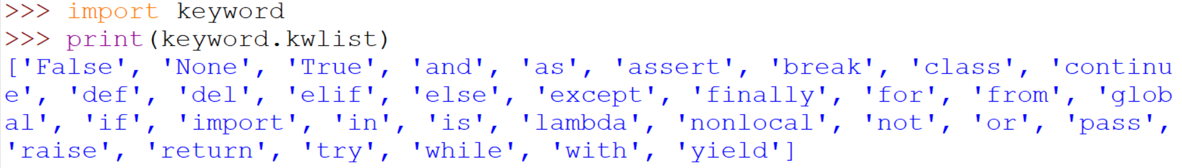
KEYWORDS
Keywords: Keywords are the reserved words in Python. We cannot use a keyword as a variable name, function name or any other identifier.
All the keywords except True, False and None are in lowercase and they must be written as they are.

Slide 12
IDENTIFIERS
Identifier/Variable: A variable is a named location used to store data in the memory. It is helpful to think of variables as a container that holds data that can be changed later in the program.
Rules for writing identifiers:
Identifiers can be a combination of letters in lowercase (a to z) or uppercase (A to Z) or digits (0 to 9) or an underscore _. Names like myClass, var_1 and print_this_to_screen, all are valid example.
An identifier cannot start with a digit. 1variable is invalid, but variable1 is a valid name.
Keywords cannot be used as identifiers.
The first character of the variable must be an alphabet or underscore ( _ ).
Identifier name must not contain any white-space, or special character (!, @, #, %, ^, &, *).
Identifier names are case sensitive; for example, my name, and MyName is not the same.

Slide 13
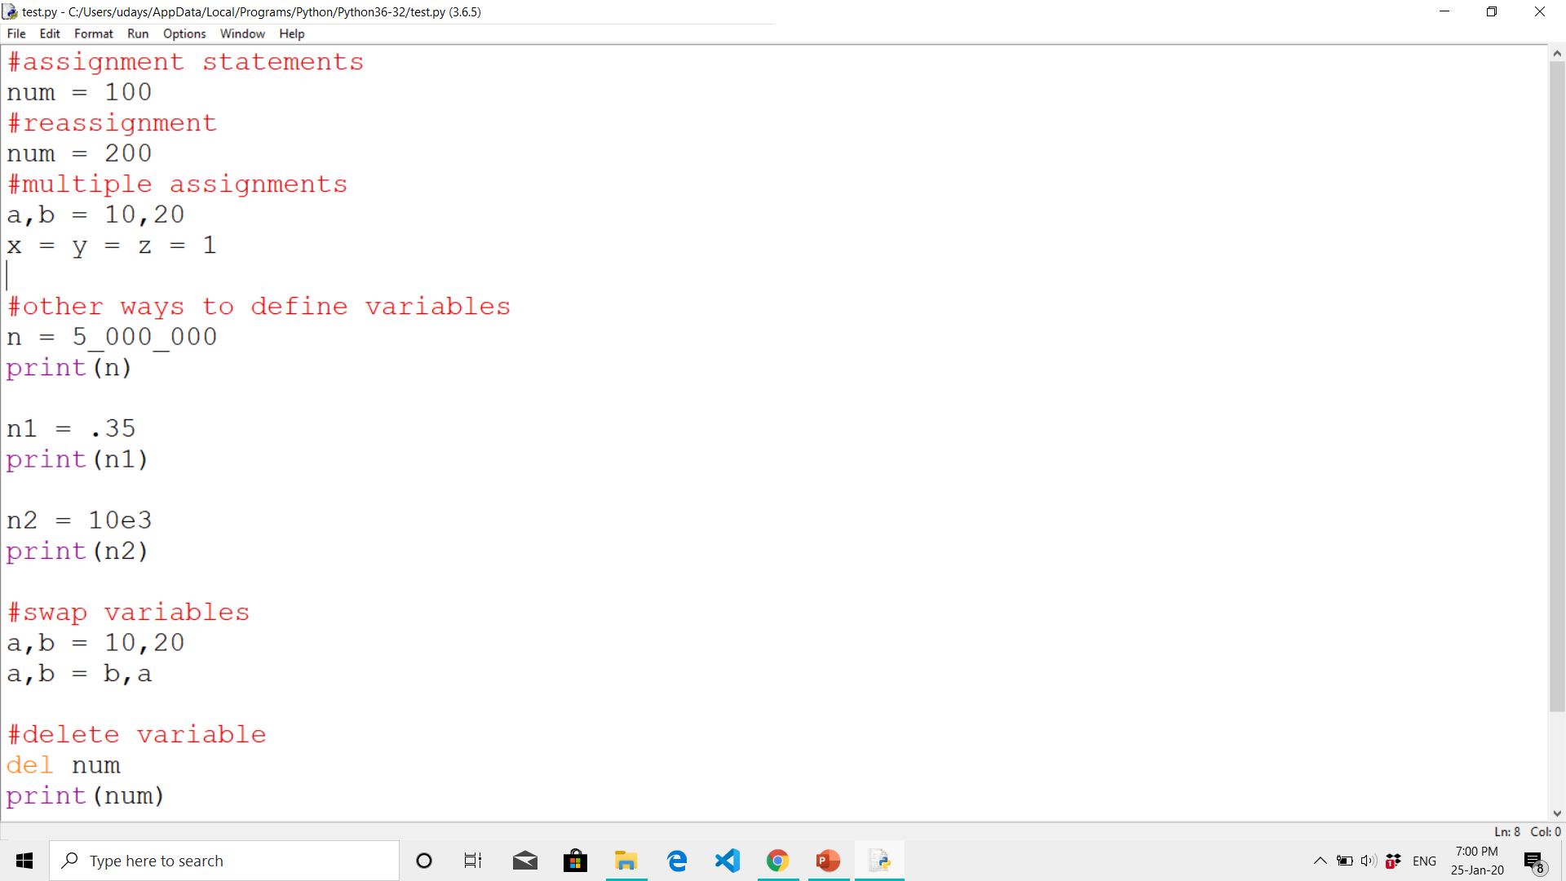
Identifiers/Variables
Examples of valid identifiers: a123, _n, n_9, etc.
Examples of invalid identifiers: 1a, n%4, n 9, etc.
Assigning and Reassigning Variables
Multiple assignment
Swapping Variables
Deleting Variables

Slide 14
Reading Input from the keyboard
Taking input is a way of interact with users, or get data to provide some result. Python provides two built-in methods to read the data from the keyboard. These methods are given below.
input(prompt)
raw_input(prompt)
input()
The input function is used in all latest version of the Python. It takes the input from the user and then evaluates the expression. The Python interpreter automatically identifies the whether a user input a string, a number, or a list.
raw_input()
The raw_input function takes the input from the keyboard and return as a string.

Slide 15
Reading Input from the keyboard
Example 1:
# Python program showing
# a use of input()
name = input("Enter your name: ") # String Input
age = int(input("Enter your age: ")) # Integer Input
marks = float(input("Enter your marks: ")) # Float Input
print("The name is:", name)
print("The age is:", age)
print("The marks is:", marks)
Example 2:
# Python program showing
# a use of raw_input()
name = raw_input("Enter your name : ")
print name
Output:
Enter your name: Johnson
Enter your age: 21
Enter your marks: 89
The name is: Johnson
The age is 21
The marks is: 89.0
Output:
Enter your name: Peter
Peter

Slide 16

PYTHON OPERATORS
Operator:
The operator can be defined as a symbol which is responsible for a particular operation between two operands.
Python provides a variety of operators, which are described as follows.
Arithmetic operators
Comparison operators
Assignment Operators
Logical Operators
Bitwise Operators
Membership Operators
Identity Operators

Slide 17
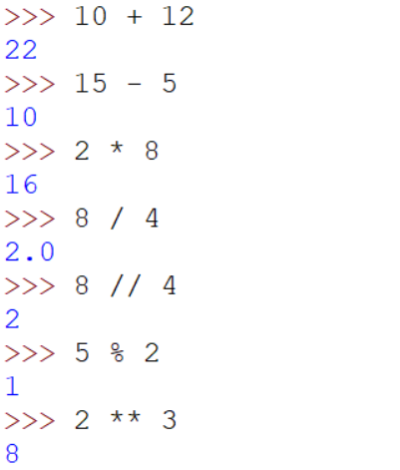
PYTHON OPERATORS
Arithmetic operators :
Arithmetic operators are used to perform arithmetic operations between two operands. It includes
Addition (+)
Subtraction (-)
Multiplication (*)
Division (/)
Floor division (//)
Modulus (%)
Exponentiation (**)

Slide 18
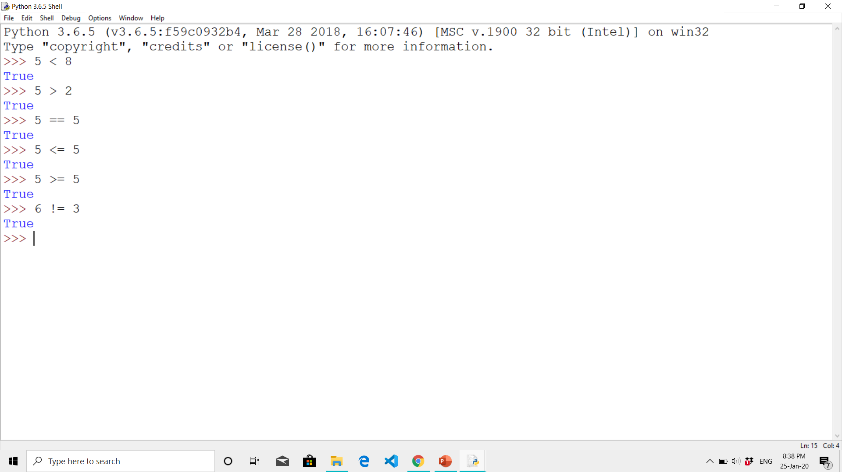
PYTHON OPERATORS
Relational operators :
Relational operators are used to comparing the value of the two operands and returns Boolean true or false accordingly.
Less than ( < )
Greater than ( > )
Equal to ( == )
Less than equal to ( <= )
Greater than equal to ( >= )
Not equal to ( != )

Slide 19
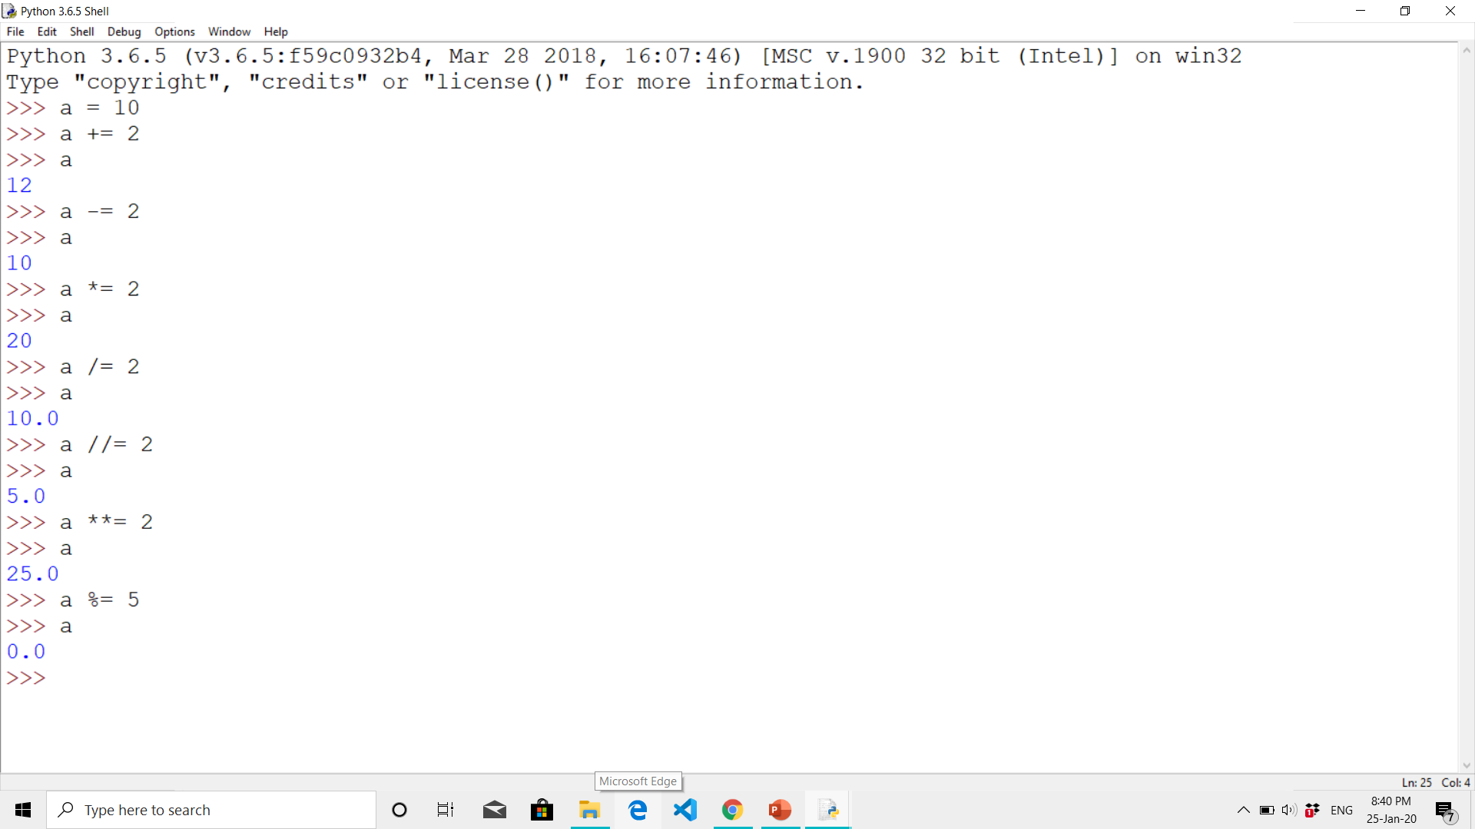
PYTHON OPERATORS
Assignment operators :
The assignment operators are used to assign the value of the right expression to the left operand.
Assign ( = )
Add and assign ( += )
Subtract and assign ( -= )
Multiply and assign ( *= )
Divide and assign ( /= )
Modulus and assign ( %= )
Floor divide and assign ( //= )
Exponent and assign ( **= )

Slide 20
PYTHON OPERATORS
Logical operator :The logical operators are used primarily in the expression evaluation to make a decision.
and
or
Not
Membership operator : Python membership operators are used to check the membership of value inside a Python data structure. If the value is present in the data structure, then the resulting value is true otherwise it returns false.
in
not in

Slide 21
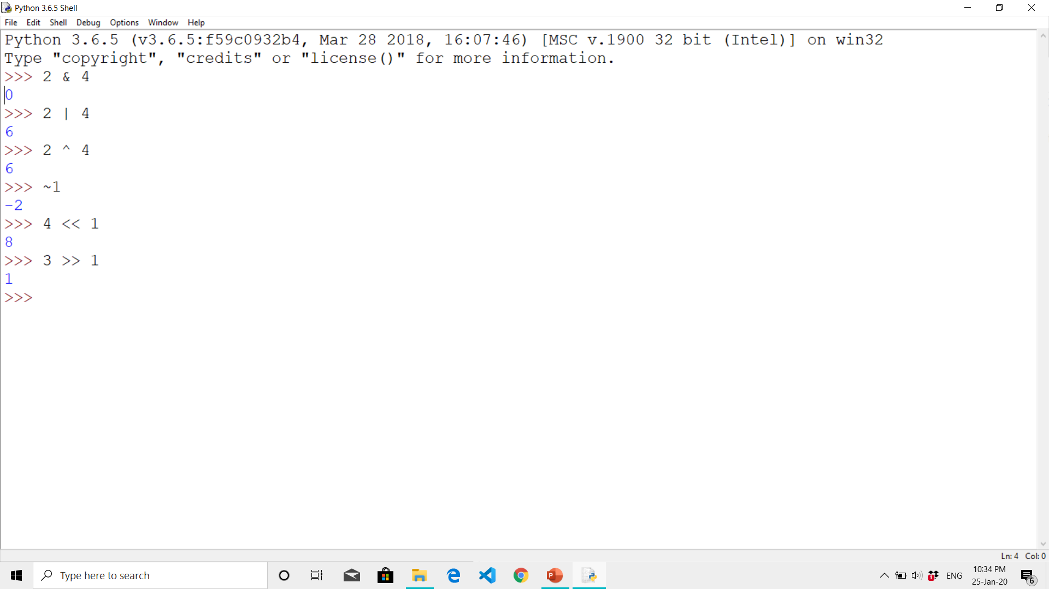
PYTHON OPERATORS
Identity operator :The identity operators are used to decide whether an element certain class or type.
is
is not
Bitwise operator : The bitwise operators perform bit by bit operation on the values of the two operands.
Binary AND ( & )
Binary OR ( | )
Binary XOR ( ^ )
Binary One’s complement ( ~ )
Binary Left-shift ( << )
Binary Right-shift ( >> )

Slide 22
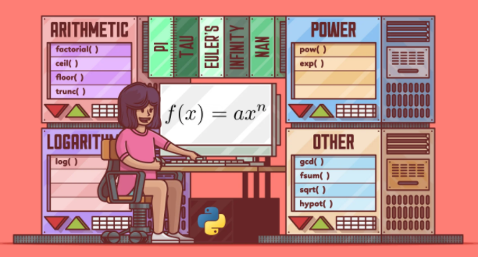
Performing Calculations
For straightforward mathematical calculations in Python, you can use the built-in mathematical operators, such as addition (+), subtraction (-), division (/), and multiplication (*). But more advanced operations, such as exponential, logarithmic, trigonometric, or power functions, are not built in.
Python provides a module specifically designed
for higher-level mathematical operations:
the math module.
Command to import the math module is:
>>> import math

Slide 23
Examples
Example 1:
Using Arthematic Operators
#Store input numbers:
num1 = input('Enter first number: ')
num2 = input('Enter second number: ')
# Add two numbers
sum = float(num1) + float(num2)
# Subtract two numbers
min = float(num1) - float(num2)
# Multiply two numbers
mul = float(num1) * float(num2)
#Divide two numbers
div = float(num1) / float(num2)
# Display the sum
print('The sum of {0} and {1} is {2}'.format(num1, num2, sum))

Slide 24
Examples
Cont.,.
# Display the subtraction
print('The subtraction of {0} and {1} is {2}'.format(num1, num2, min))
# Display the multiplication
print('The multiplication of {0} and {1} is {2}'.format(num1, num2, mul))
# Display the division
print('The division of {0} and {1} is {2}'.format(num1, num2, div))
Output:
Enter first number: 10
Enter second number: 20
The sum of 10 and 20 is 30.0
The subtraction of 10 and 20 is -10.0
The multiplication of 10 and 20 is 200.0
The division of 10 and 20 is 0.5

Slide 25
Examples
Example 2:
Using math.log10()
import math
x=13 # small value of of x
print('log10(x) is :', math.log10(x))
Example 2:
Using math.exp()
import math
number = 5e-2 # small value of of x
print('The given number (x) is :', number)
print('e^x (using exp() function) is :', math.exp(number)-1)
Output:
log10(x) is : 1.1139433523068367
Output:
The given number (x) is : 0.05
e^x (using exp() function) is : 0.05127109637602412

Slide 26
Examples
Example 2: Using math.pow(x,y)
import math
number = math.pow(10,2)
print("The power of number:",number)
Output:
The power of number: 100.0
Example 2: Using math.exp()
import math
number = math.factorial(7)
print("The factorial of number:",number)
Output:
The factorial of number: 5040

Slide 27
DATA TYPES
Data types: Variables can hold values, and every value has a data-type. Python is a dynamically typed language and hence we do not need to define the type of the variable while declaring it. The interpreter implicitly binds the value with its type.
NUMERIC
int,float,complex
TEXT
str
PYTHON DATA TYPES
SEQUENCE
list, tuple, range
MAPPING
dict
SET
set, frozenset
BOOLEAN
bool
BINARY
bytes,bytearray,memoryview

Slide 28
Numeric Data Type
int - Integer value can be any length such as integers 10, 2, 29, -20, -150 etc. Python has no restriction on the length of an integer. Its value belongs to int
float - Float is used to store floating-point numbers like 1.9, 9.902, 15.2, etc. It is accurate upto 15 decimal points.
complex - A complex number contains an ordered pair, i.e., x + iy where x and y denote the real and imaginary parts, respectively. The complex numbers like 2.14j, 2.0 + 2.3j, etc.
Example:
a = 5
print("The type of a", type(a))
b = 40.5
print("The type of b", type(b))
c = 1+3j
print("The type of c", type(c))
Output:
The type of a <class 'int'>
The type of b <class 'float'>
The type of c <class 'complex'>

Slide 29
PYTHON STRING
String: Python string is the collection of the characters surrounded by single quotes, double quotes, or triple quotes. The computer does not understand the characters; internally, it stores manipulated character as the combination of the 0's and 1's.
Syntax:
str = "Hi Python !"
Assignment of a string:
We can assign a string by enclosing the characters in single-quotes or double- quotes.
Example:
#Using single quotes
str1 = 'Hello Python'
print(str1)
#Using double quotes
str2 = "Hello Python"
print(str2)
Output:
Hello Python
Hello Python

Slide 30
STRING INDEXING
Indexing: Like other languages, the indexing of the Python strings starts from 0. For example, The string "HELLO" is indexed as shown below
Str=“HELLO”
H E L L O
0 1 2 3 4
Str[0]=‘H’
Str[1]=‘E’
Str[2]=‘L’
Str[3]=‘L’
Str[4]=‘0’

Slide 31
STRING INDEXING
Example:
str = "HELLO"
print(str[0])
print(str[1])
print(str[2])
print(str[3])
print(str[4])
# It returns the IndexError because 6th index doesn't exist
print(str[6])
Output:
H
E
L
L
O
IndexError: string index out of range

Slide 32
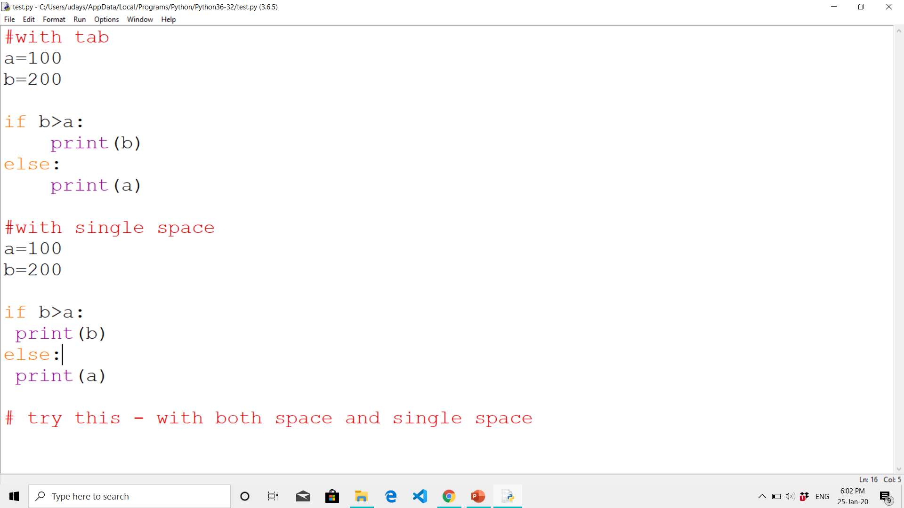
INDENTATION

Slide 33
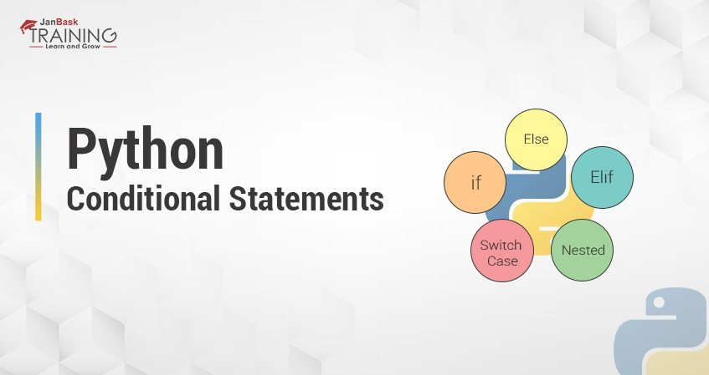
CONDITIONAL STATEMENTS

Slide 34
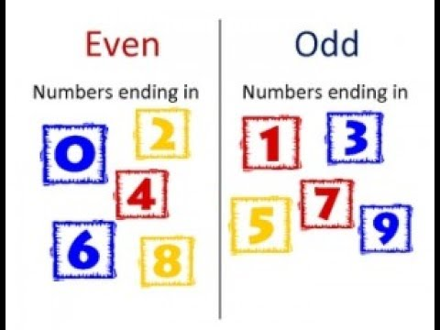

INTRODUCTION
Conditional statements are also known as decision-making statements.
For example, check whether the given number is even or odd?

Slide 35
CONDITIONAL STATEMENTS IN PYTHON
if statement
if-else statement
elif statement
nested if statements
switchcase

Slide 36
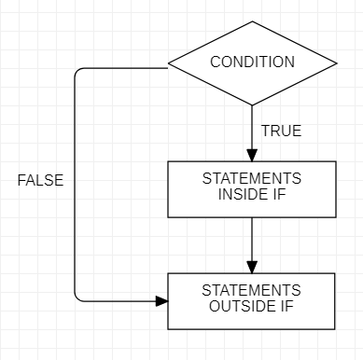
IF STATEMENT
We use if statement to check whether the condition is True or not.
If the given condition is true, then the statements inside if clause will be executed.

Slide 37
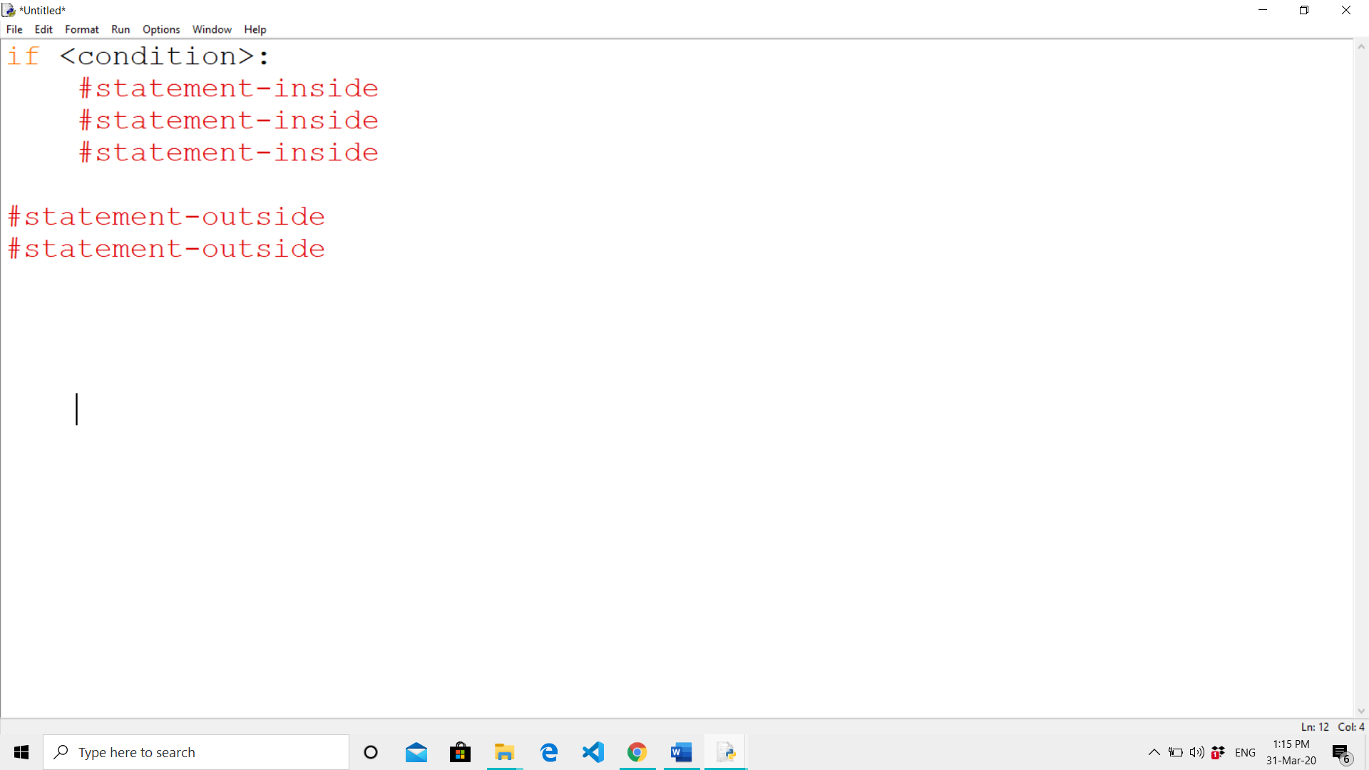
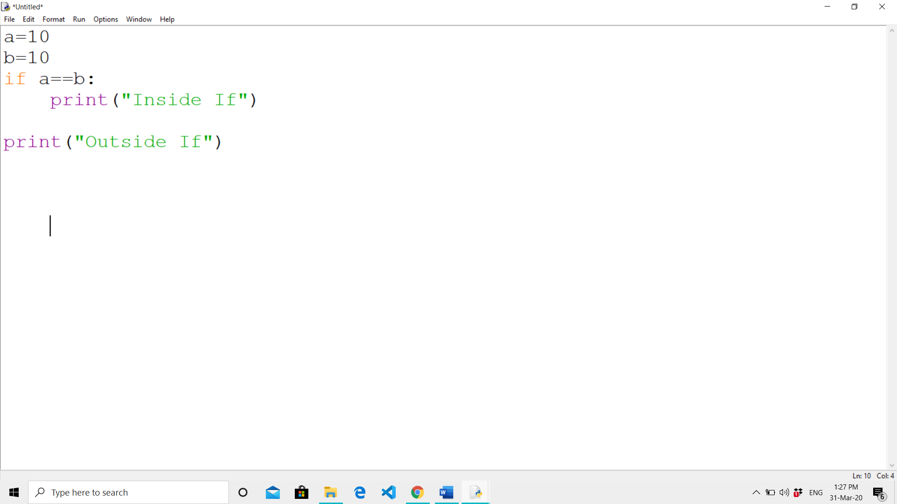
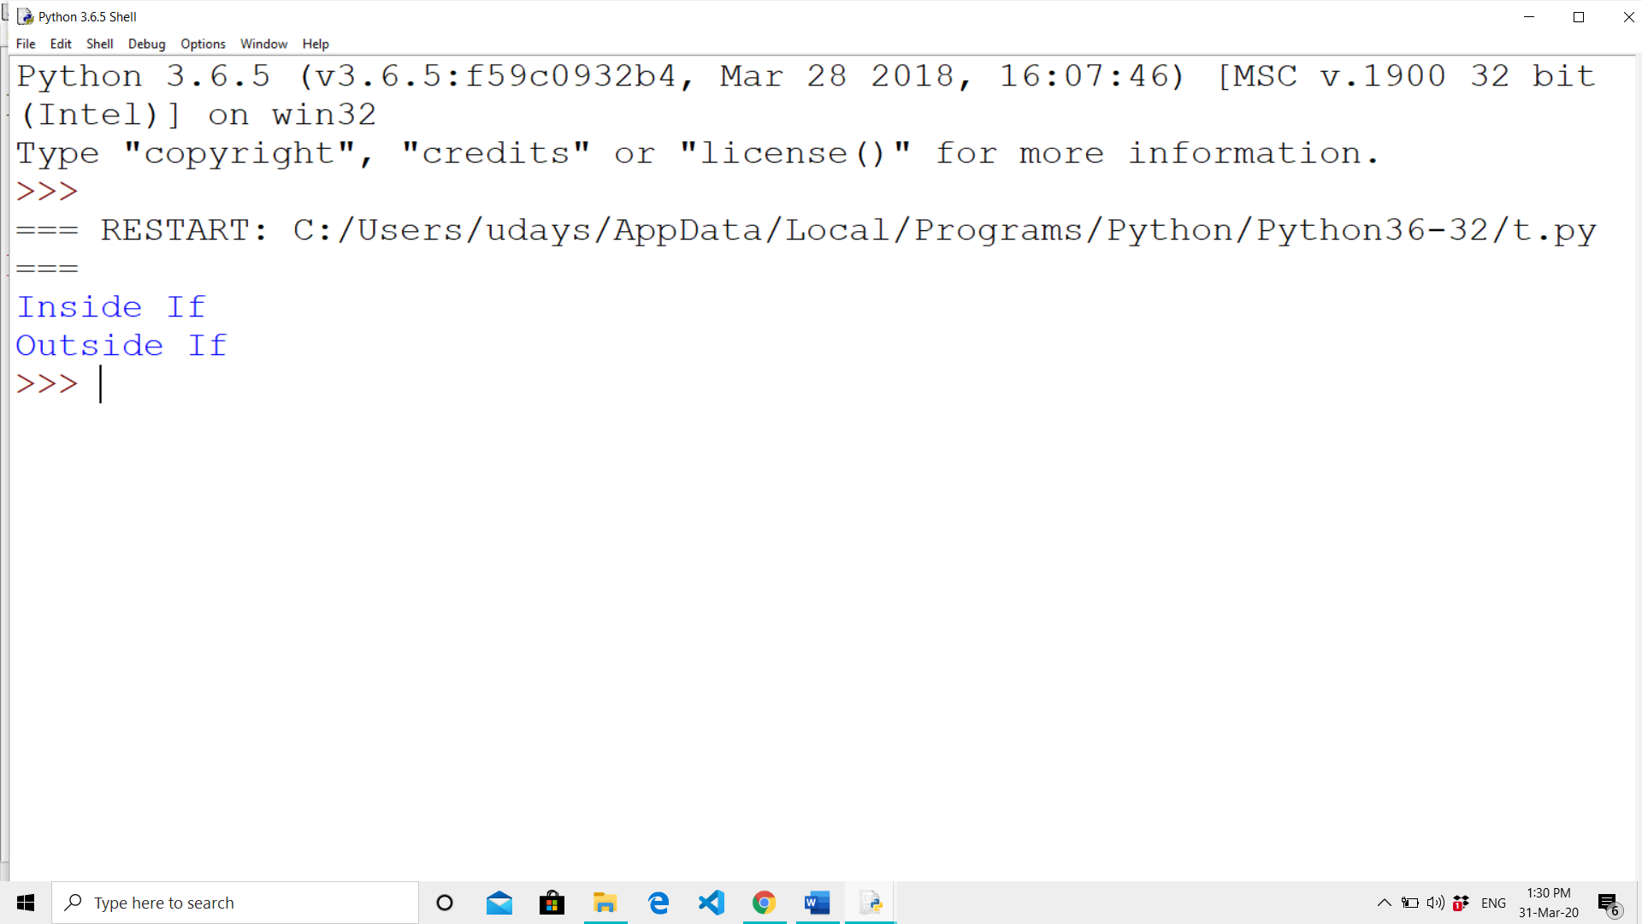
SYNTAX AND EXAMPLE
SYNTAX
EXAMPLE
OUTPUT :

Slide 38
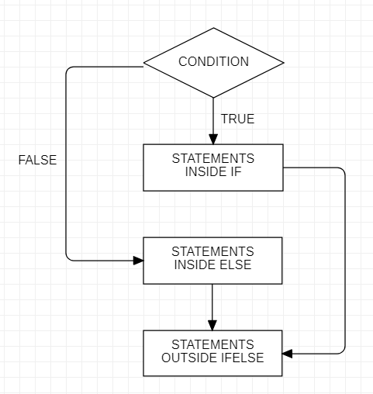
IF-ELSE STATEMENT
We use if-else clause to check whether the given condition is True or False.
If the given condition is true, then the statements inside if clause will be executed.
If the given condition is false, then the statements inside else clause will be executed.

Slide 39
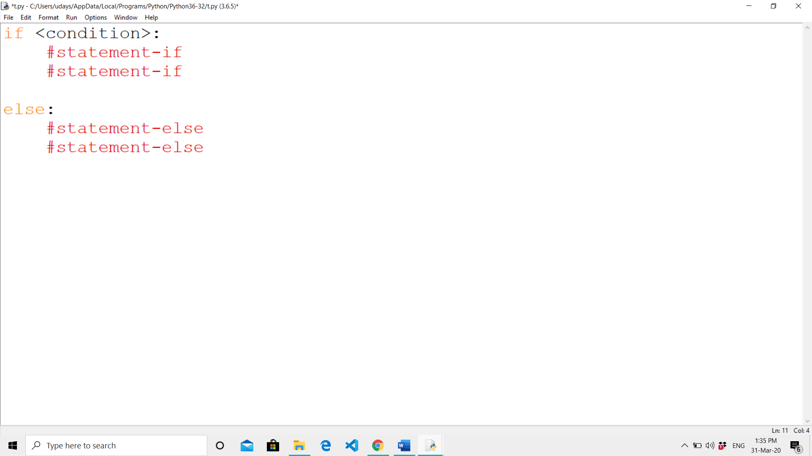
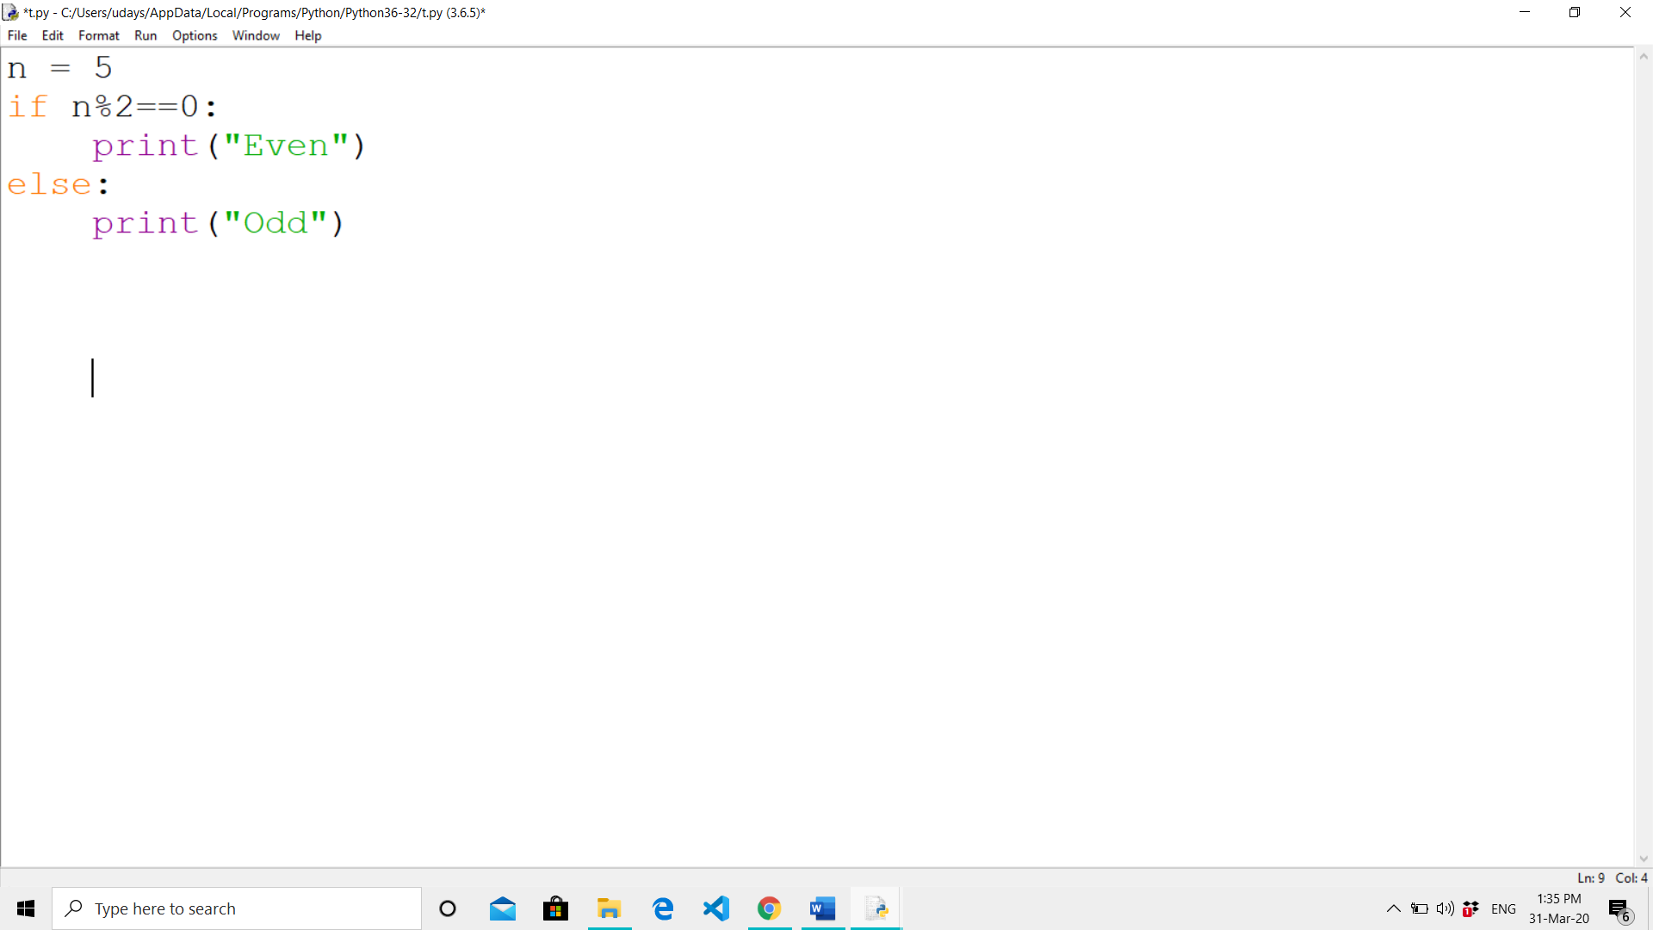
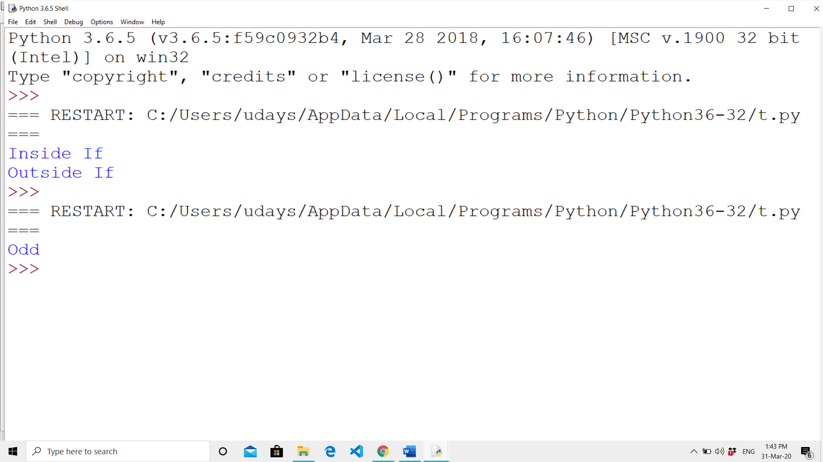
SYNTAX AND EXAMPLE
SYNTAX
EXAMPLE
OUTPUT :

Slide 40
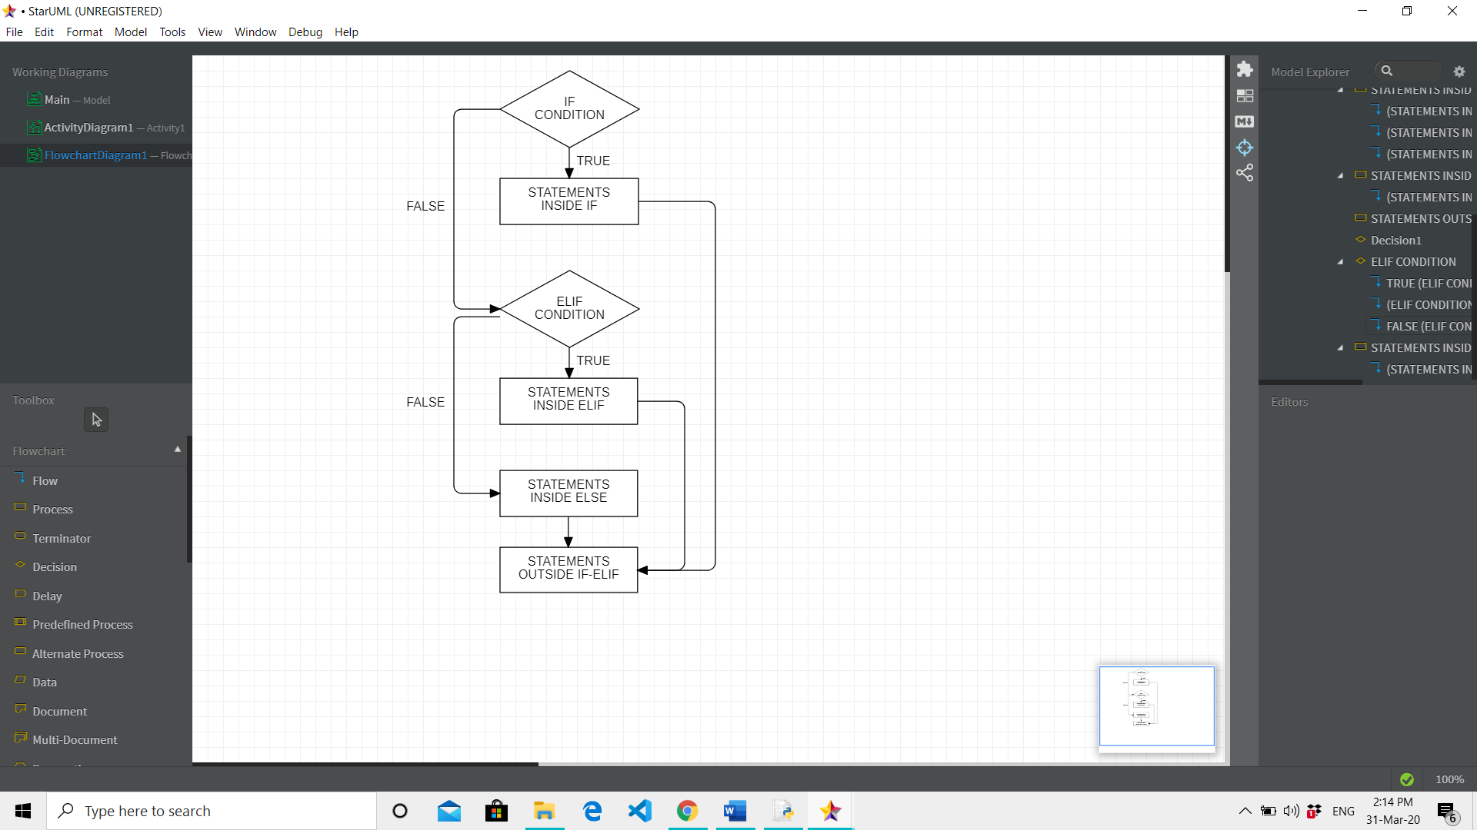
ELIF STATEMENT
We use elif statement to check for multiple conditions.
If the first if statement is False, it checks for elif statement. If the elif statement is also False, then it checks for the next elif statement.
If the next elif statement is also False, finally the else clause will be executed.

Slide 41
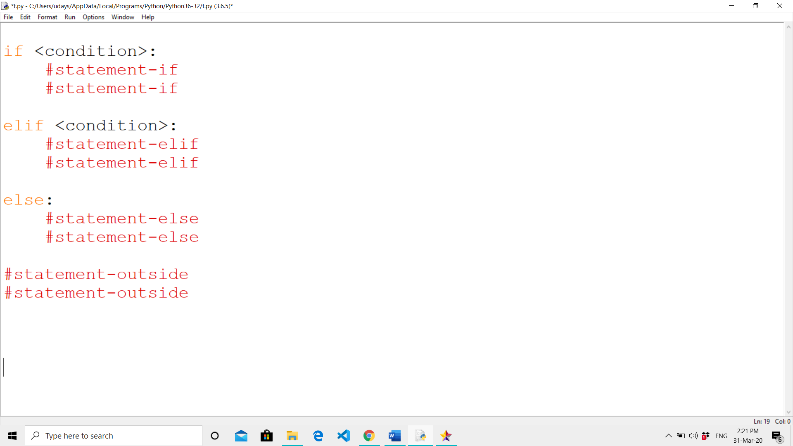
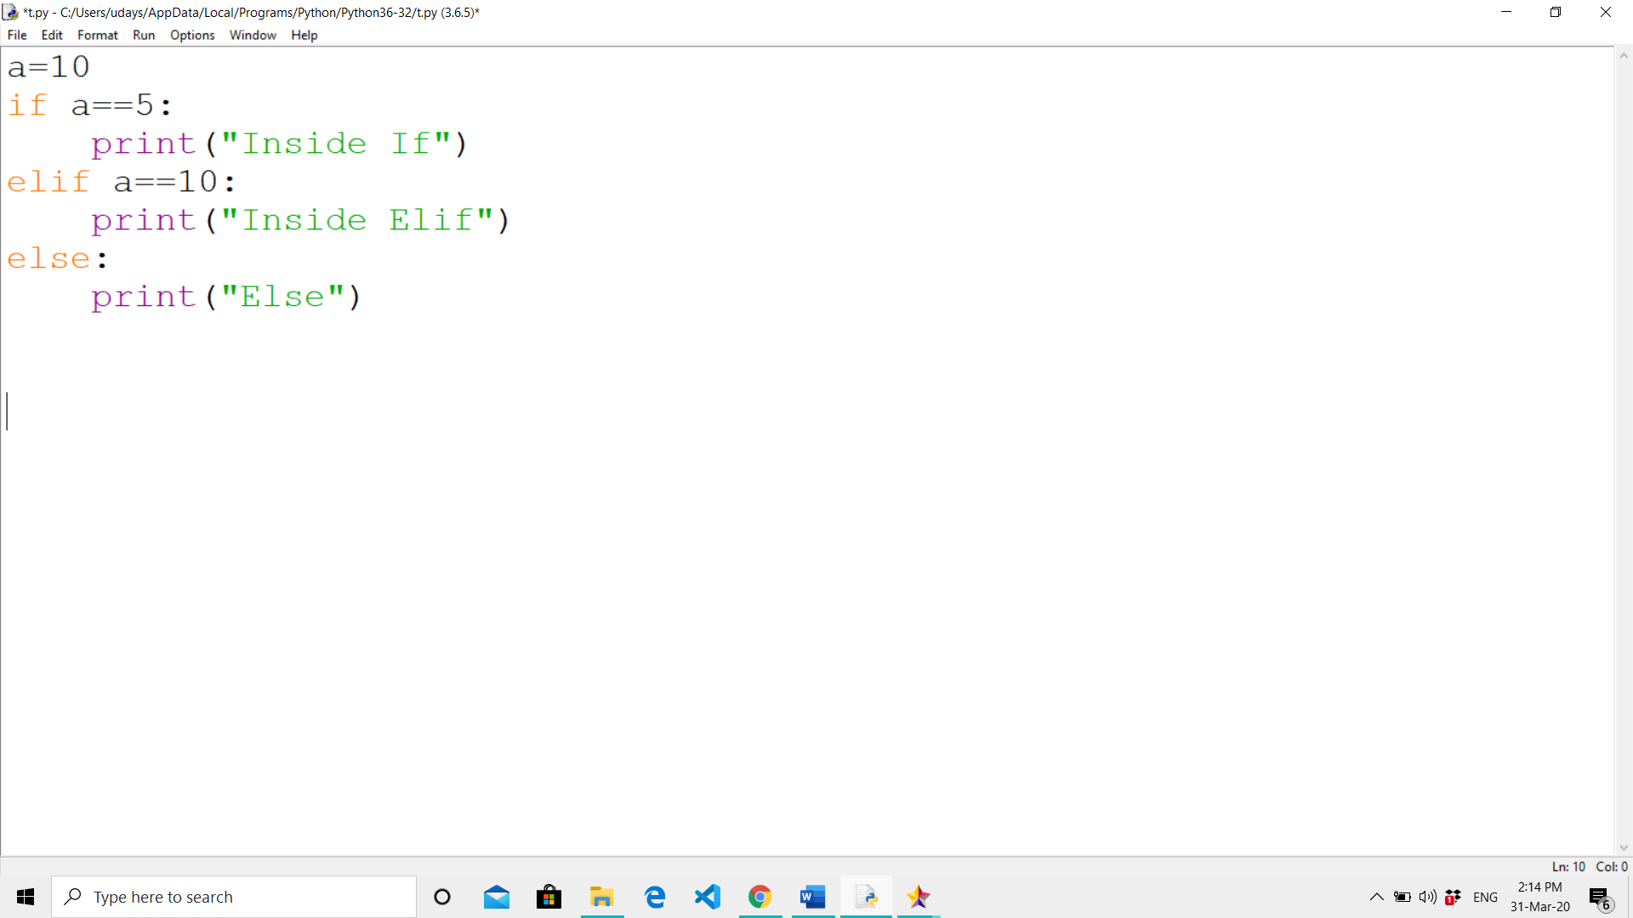
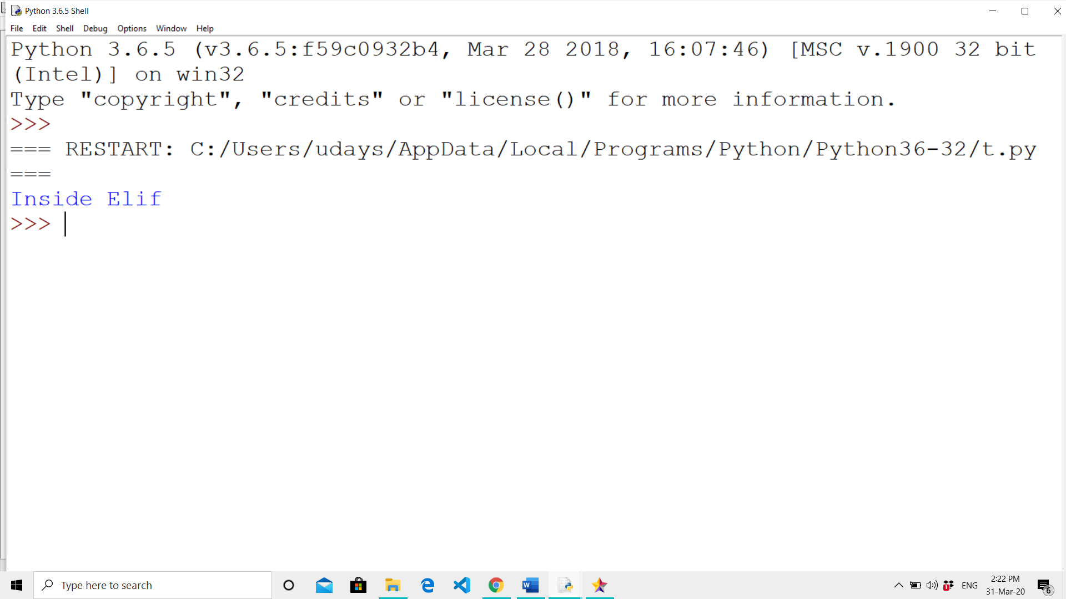
SYNTAX AND EXAMPLE
SYNTAX
EXAMPLE
OUTPUT:

Slide 42
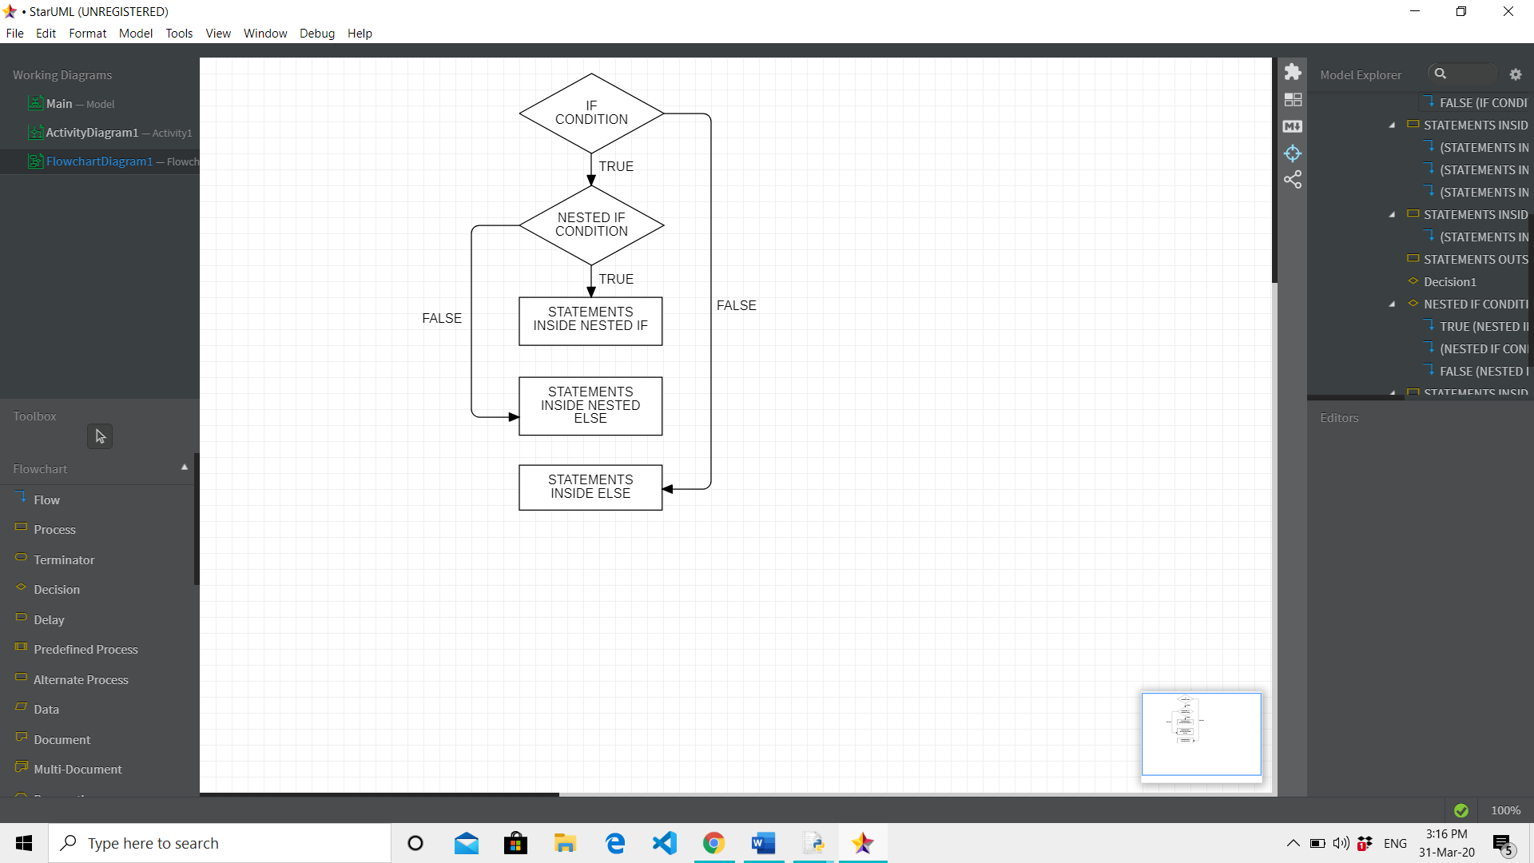
NESTED-IF STATEMENT
If statement inside another if statement is called nested if statement.
First the outer if will be checked, if the condition is True then it checks for the condition in inner if else it jumps to the else clause.

Slide 43
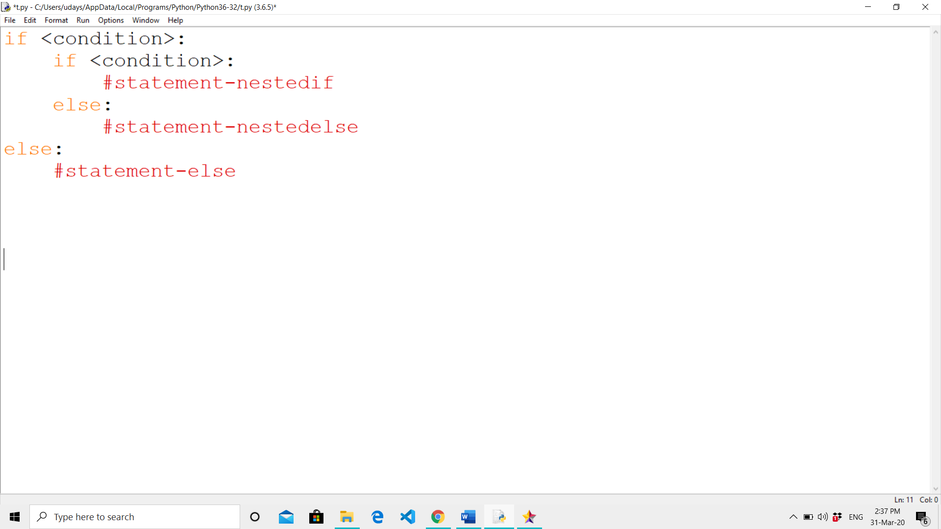
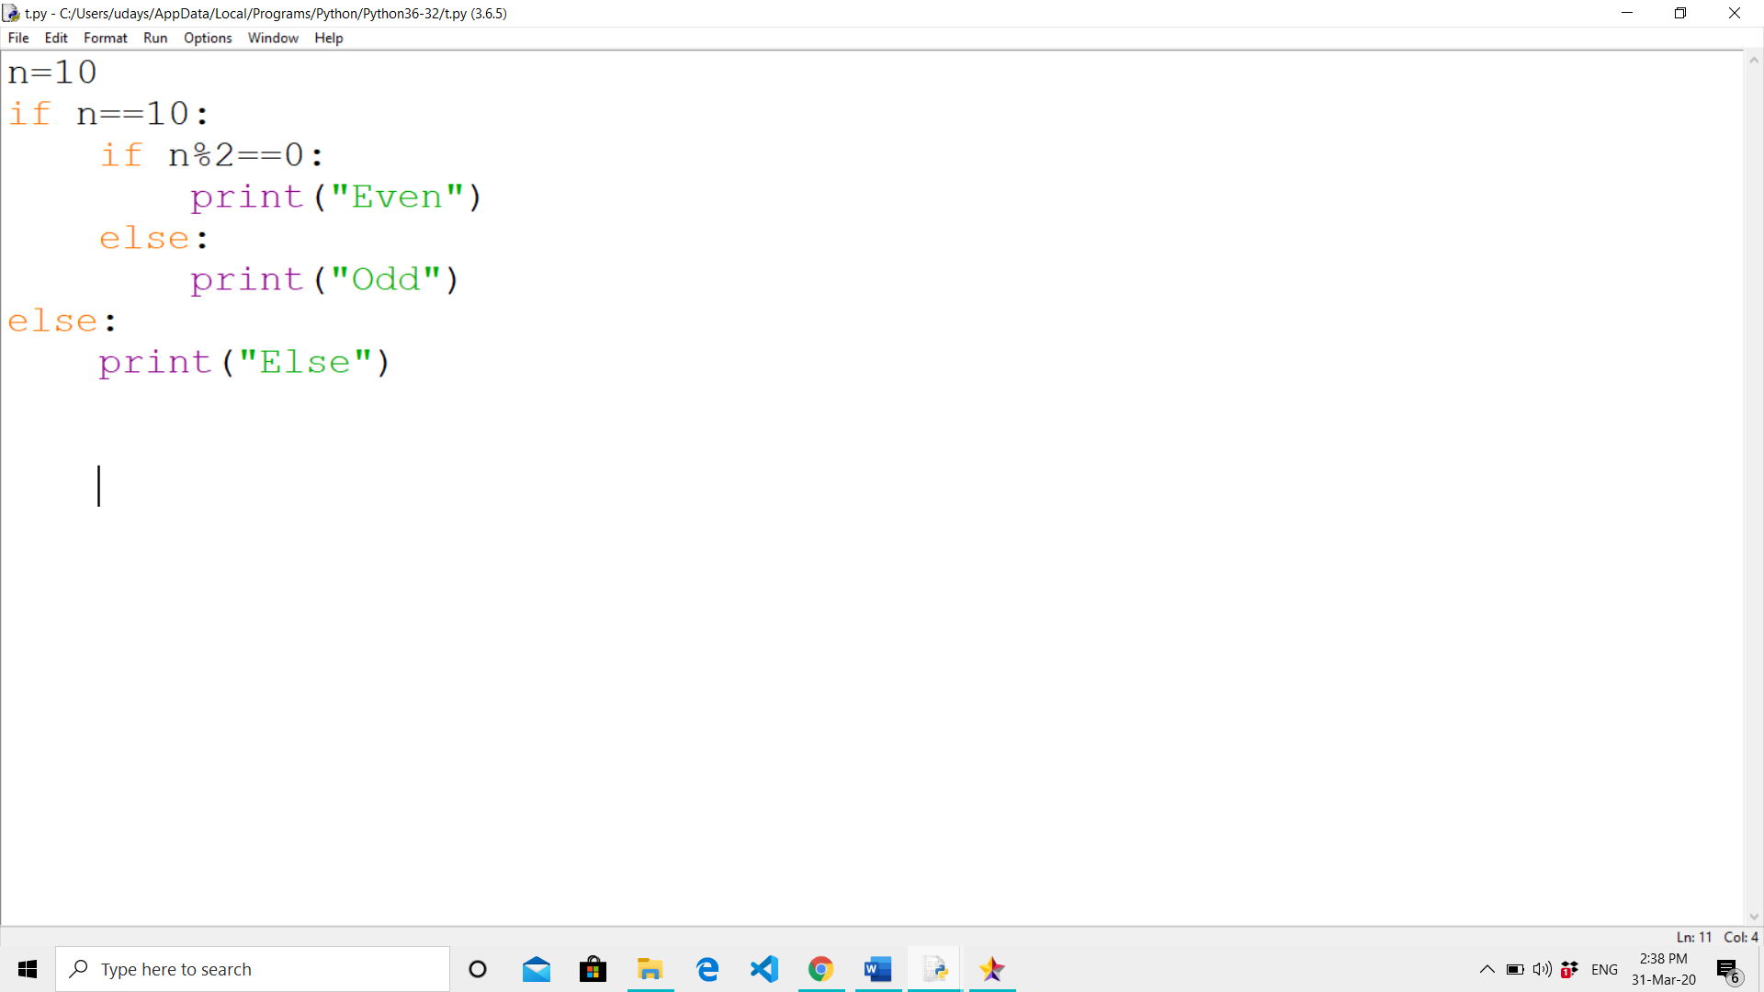
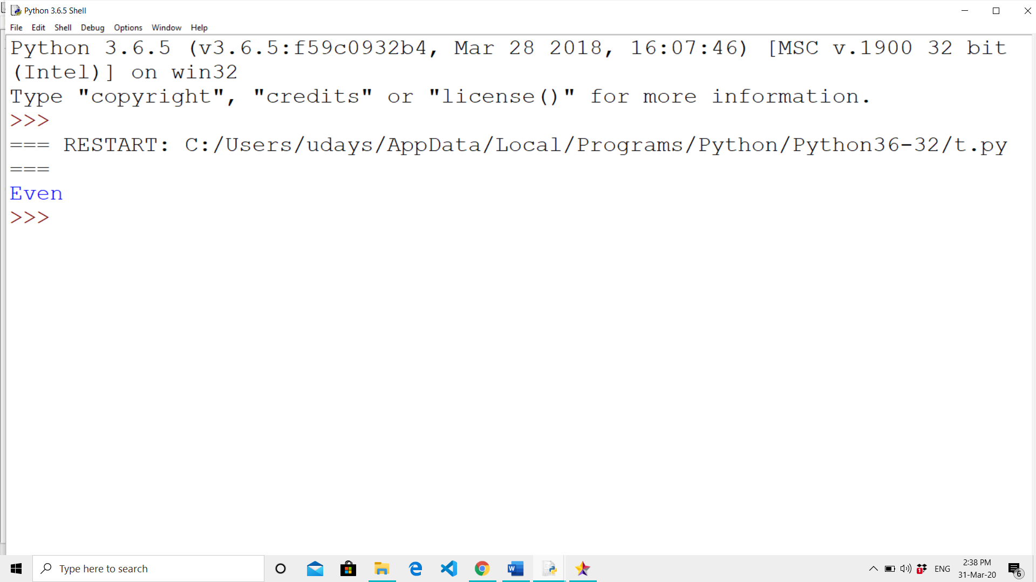
SYNTAX AND EXAMPLE
SYNTAX
EXAMPLE
OUTPUT :

Slide 44

SWITCH CASE IN PYTHON
We can use switch case to check multiple conditions.
Python doesn’t support switch case statement but it can be implemented using dictionary, functions or classes.

Slide 45
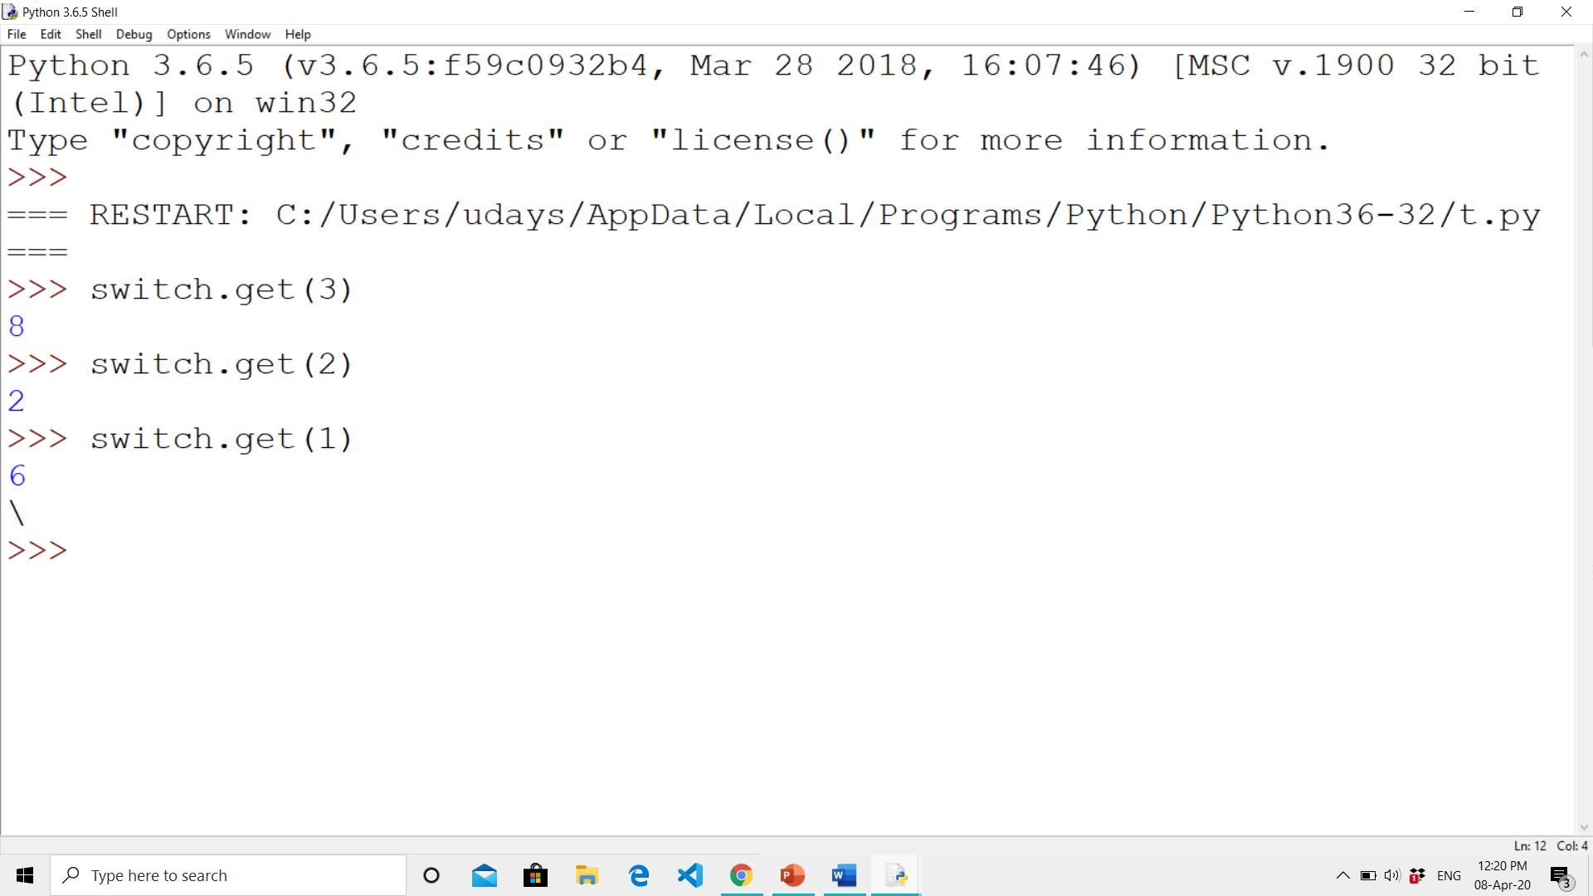
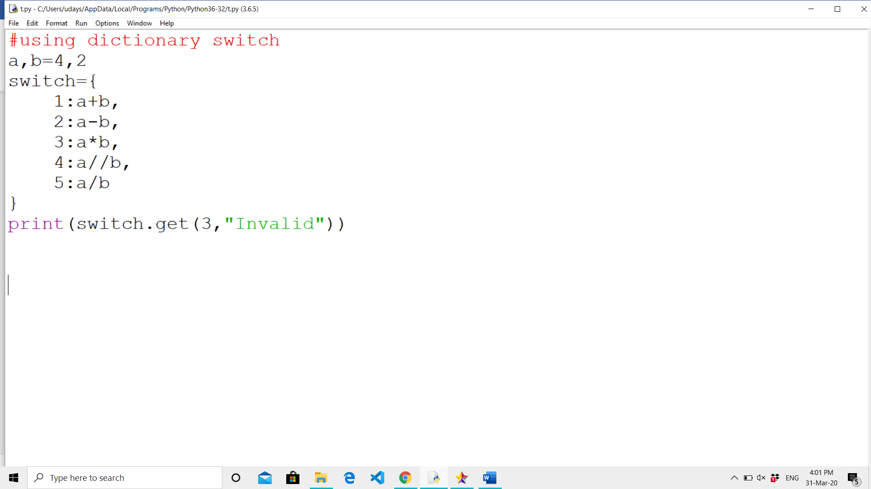
SWITCH CASE USING DICTIONARY
CODE
OUTPUT

Slide 46
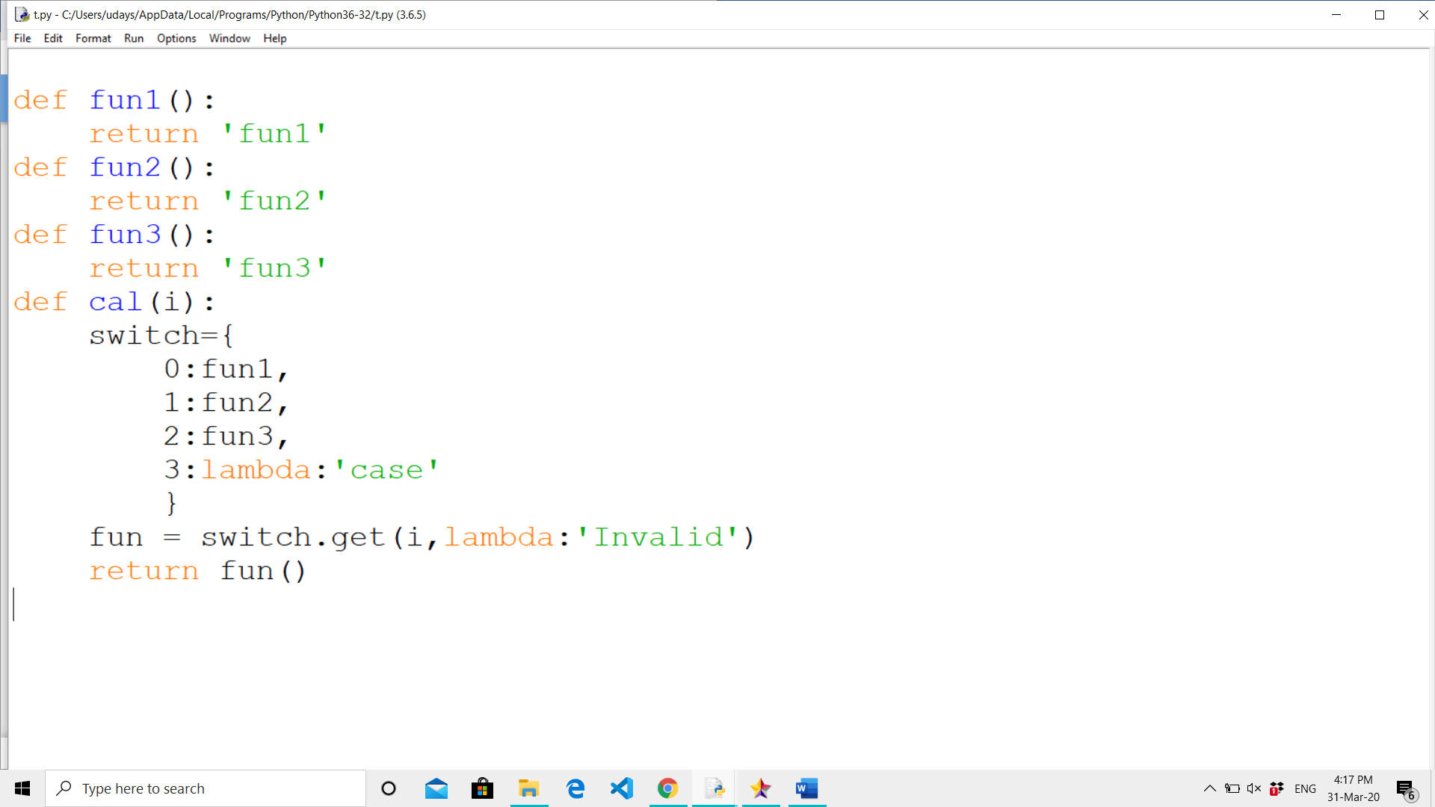
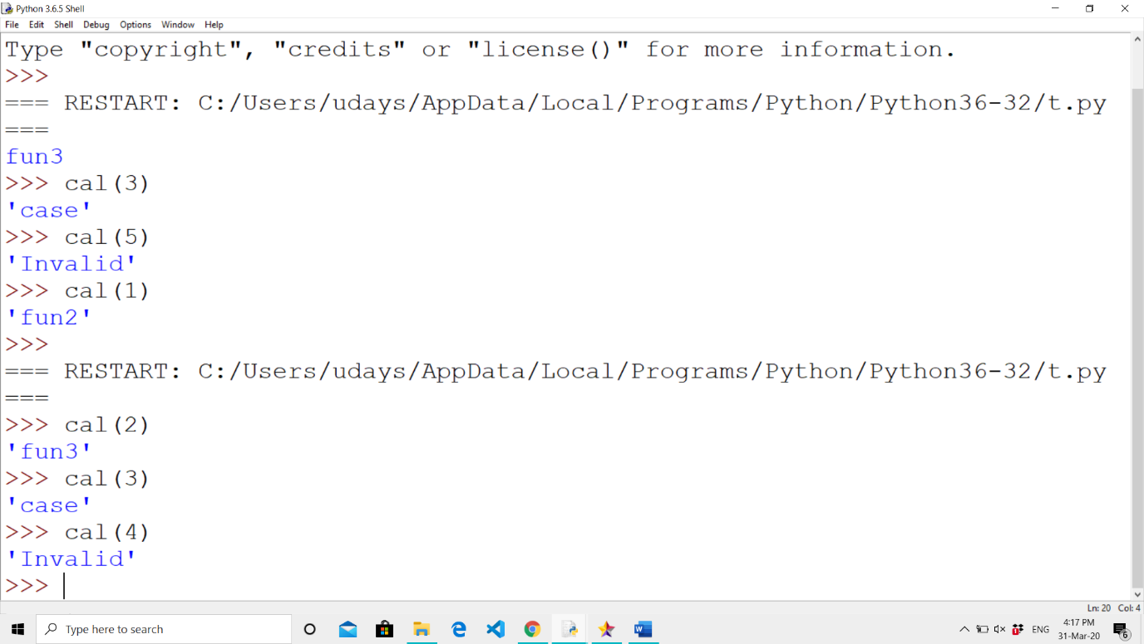
SWITCH CASE USING FUNCTIONS
CODE
OUTPUT

Slide 47
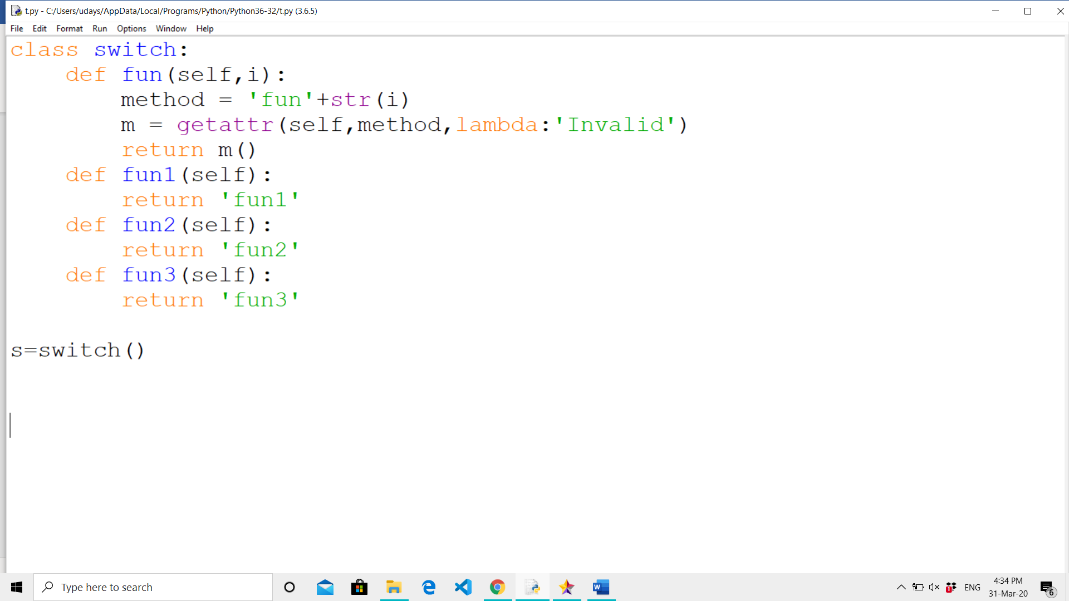
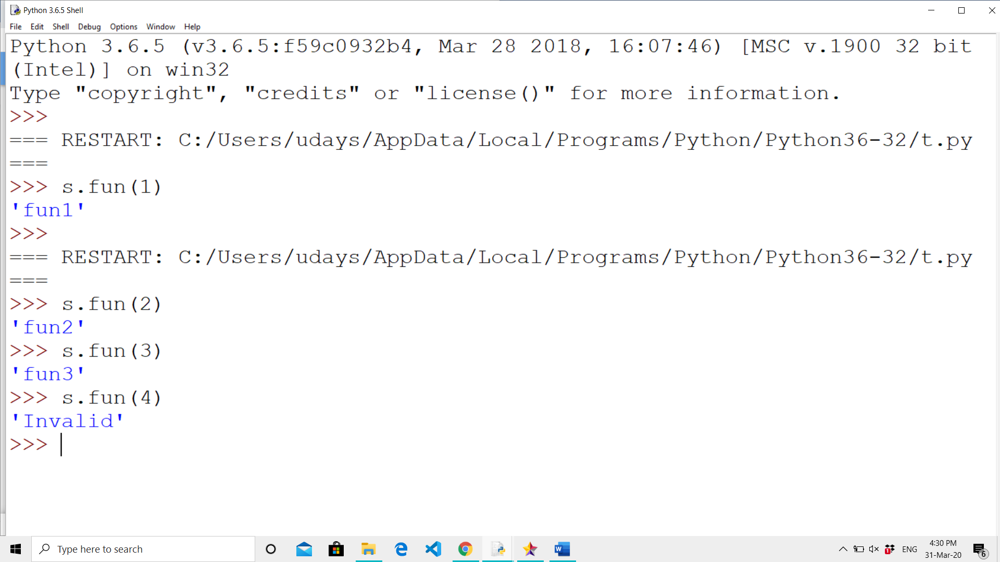
SWITCH CASE USING CLASSES
CODE
OUTPUT

Slide 48

INTRODUCTION
Loops are traditionally used when you have a block of code which you want to repeat a fixed number of times.

Slide 49
LOOPING STATEMENTS IN PYTHON
while loop
for loop
nested loop

Slide 50
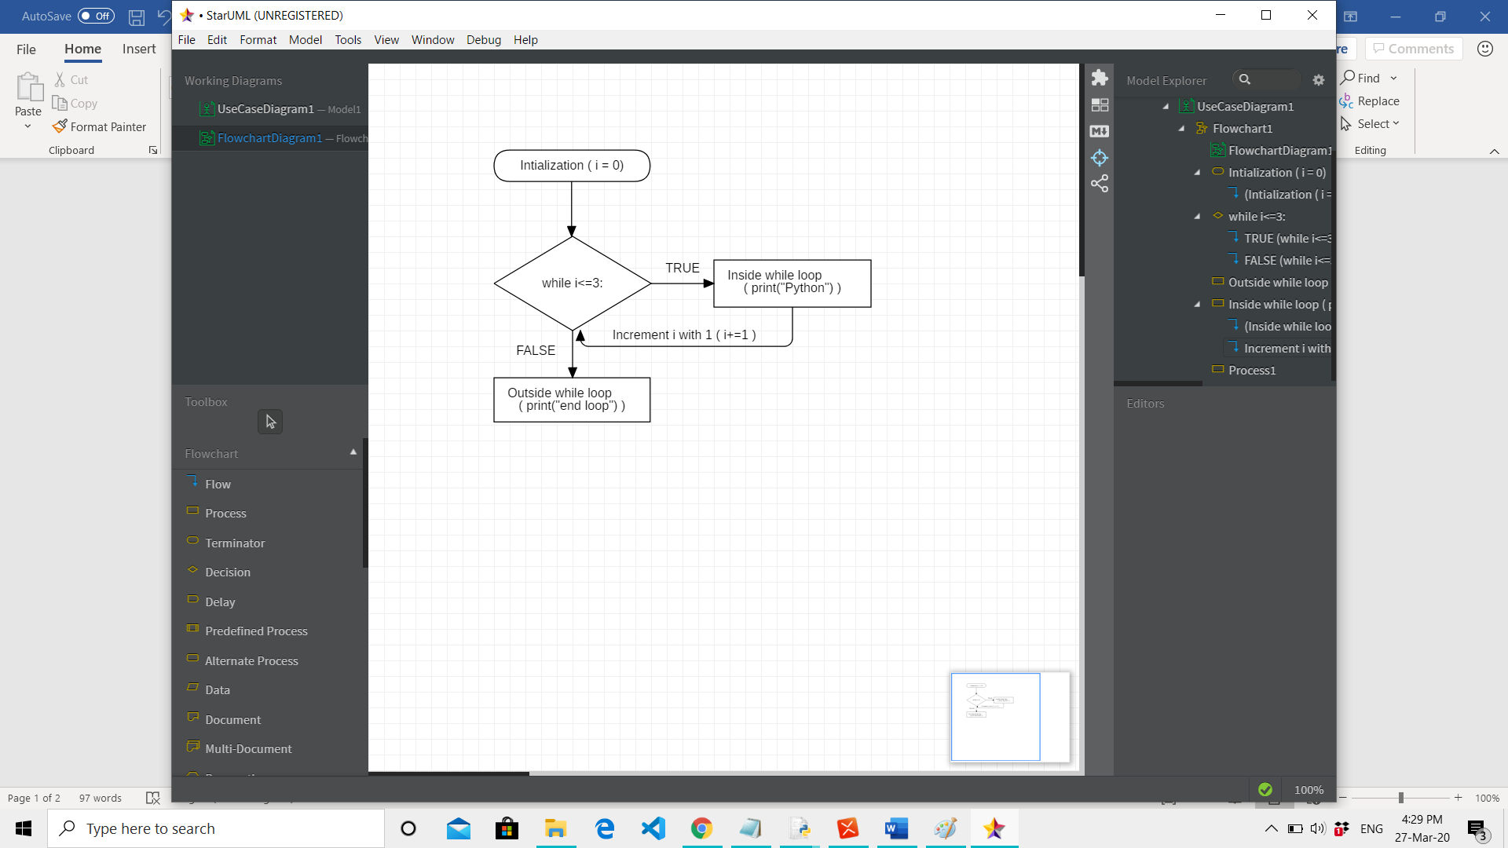
WHILE LOOP
While loop is used to execute a block of statements repeatedly until a given a condition is satisfied.

Slide 51
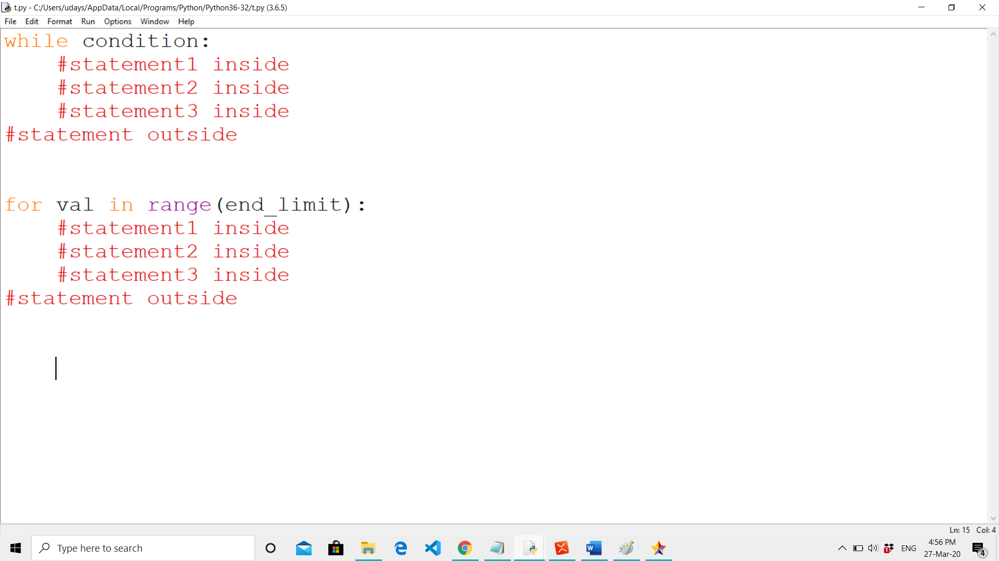
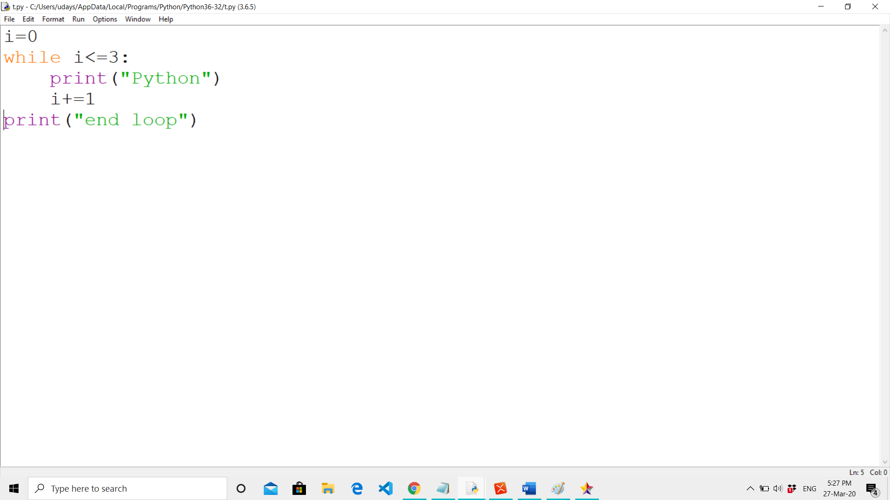
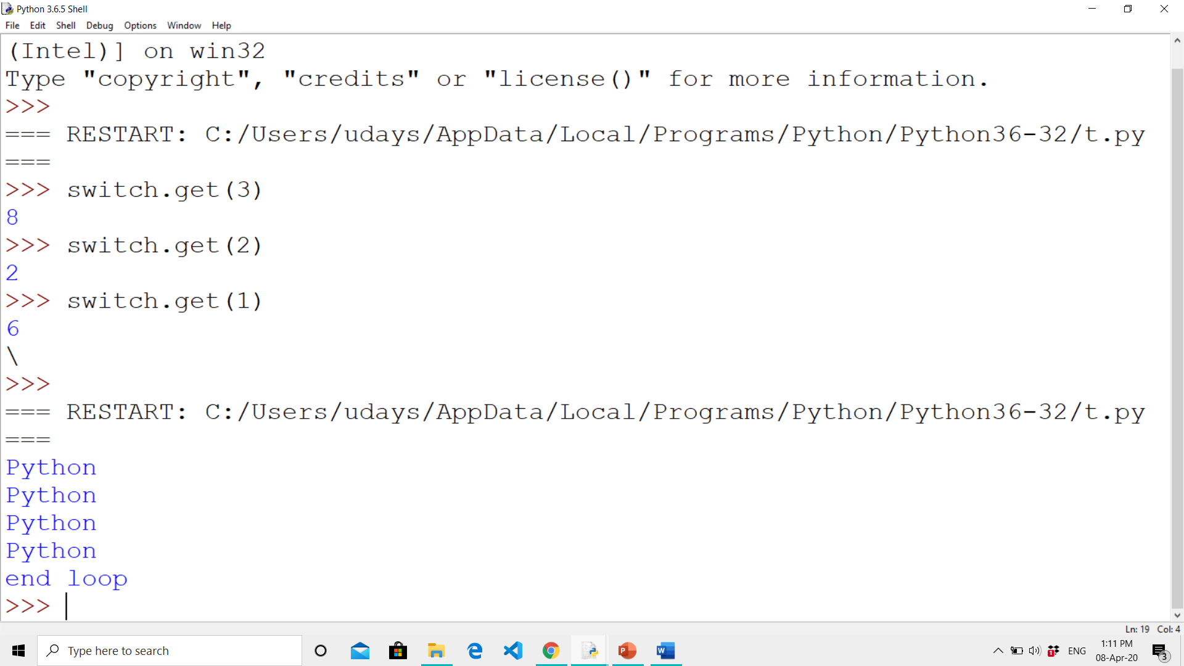
SYNTAX AND EXAMPLE
SYNTAX
EXAMPLE
OUTPUT :

Slide 52
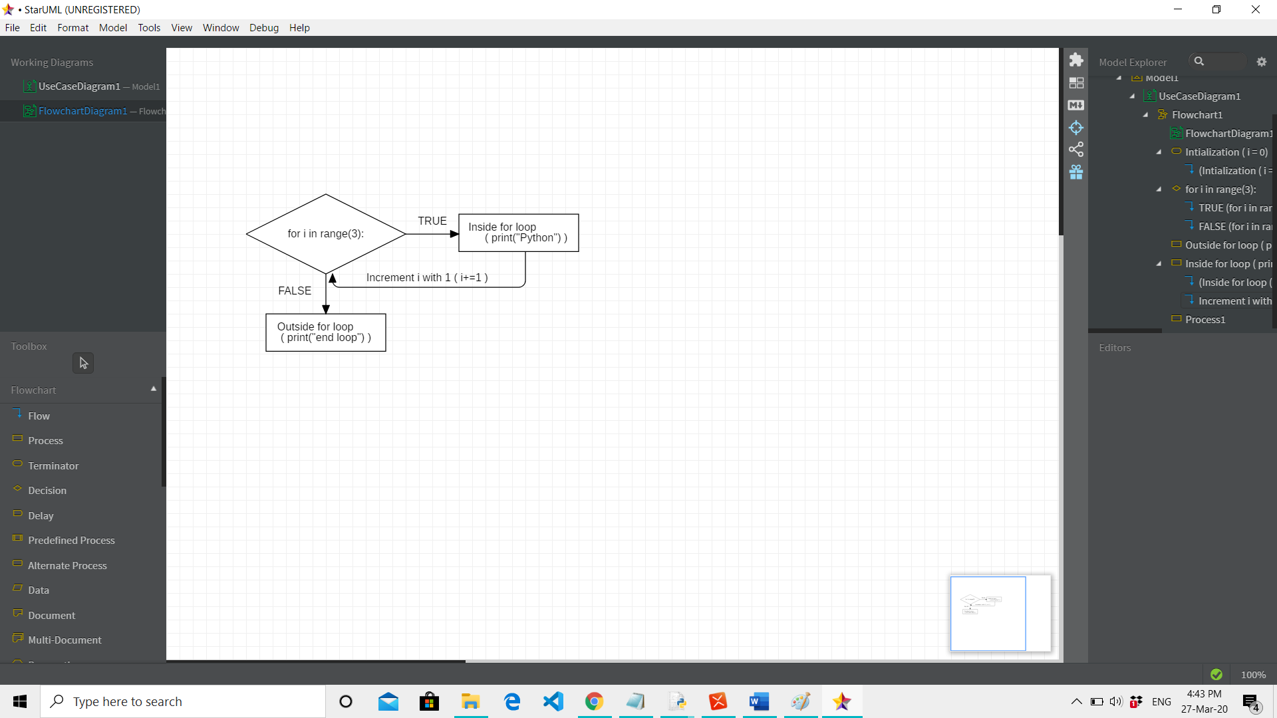
FOR LOOP
For loops are used for sequential traversal.

Slide 53
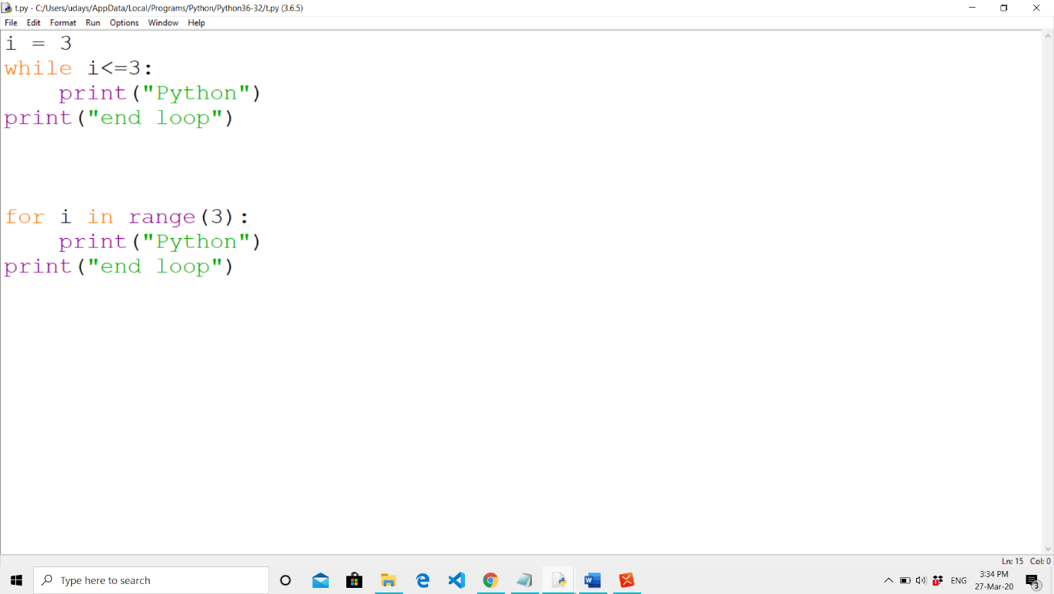
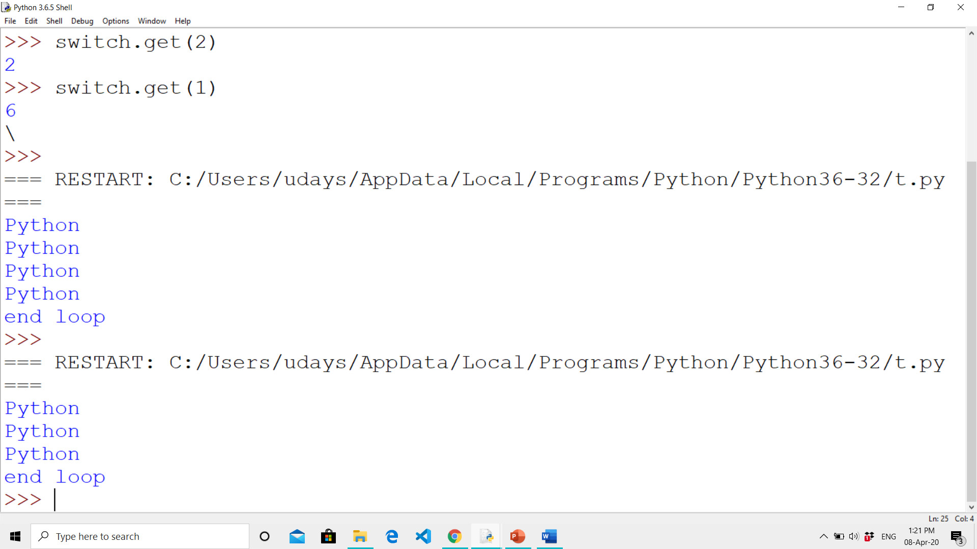
SYNTAX AND EXAMPLE
SYNTAX
EXAMPLE
OUTPUT :

Slide 54
range() FUNCTION
range() function | Explanation
Syntax: for i in range(end) Example: for i in range(3) | i value ranges from 0 till (3-1) Values are: 0, 1, 2
Syntax: for i in range(start,end) Example: for i in range(2,5) | i value ranges from 2 till 5 Values are: 2, 3, 4
Syntax: for i in range(start,end,step) Example: for i in range(5,2,-1) | i value ranges from 5 till 2 decrementing with 1 every iteration Values are: 5, 4, 3

Slide 55
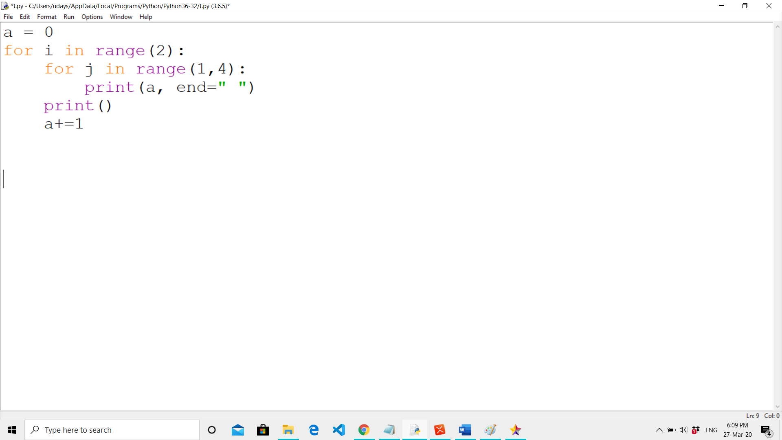
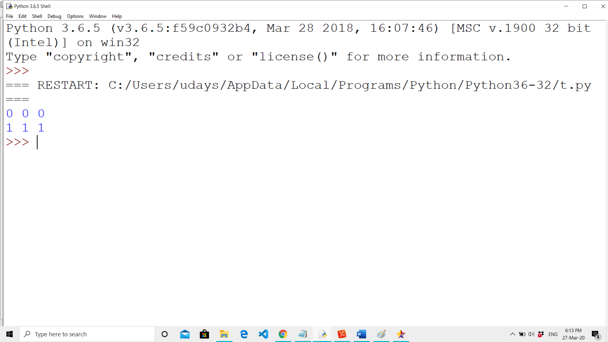
NESTED LOOP
A loop inside other loop indicates nested loops.
OUTPUT :
OUTPUT:

Slide 56
LOOP CONTROL STATEMENTS
Break statement
Continue statement
Pass statement
OUTPUT:

Slide 57
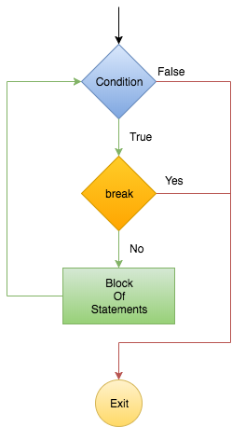
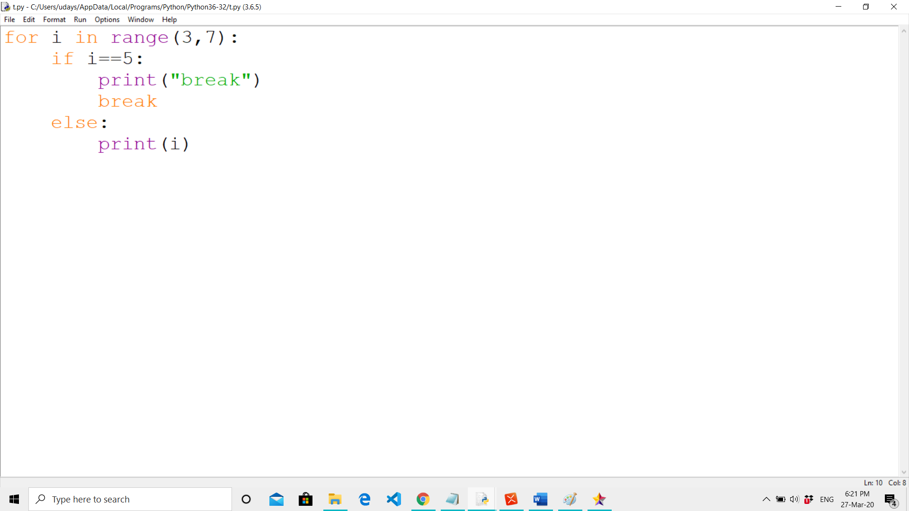
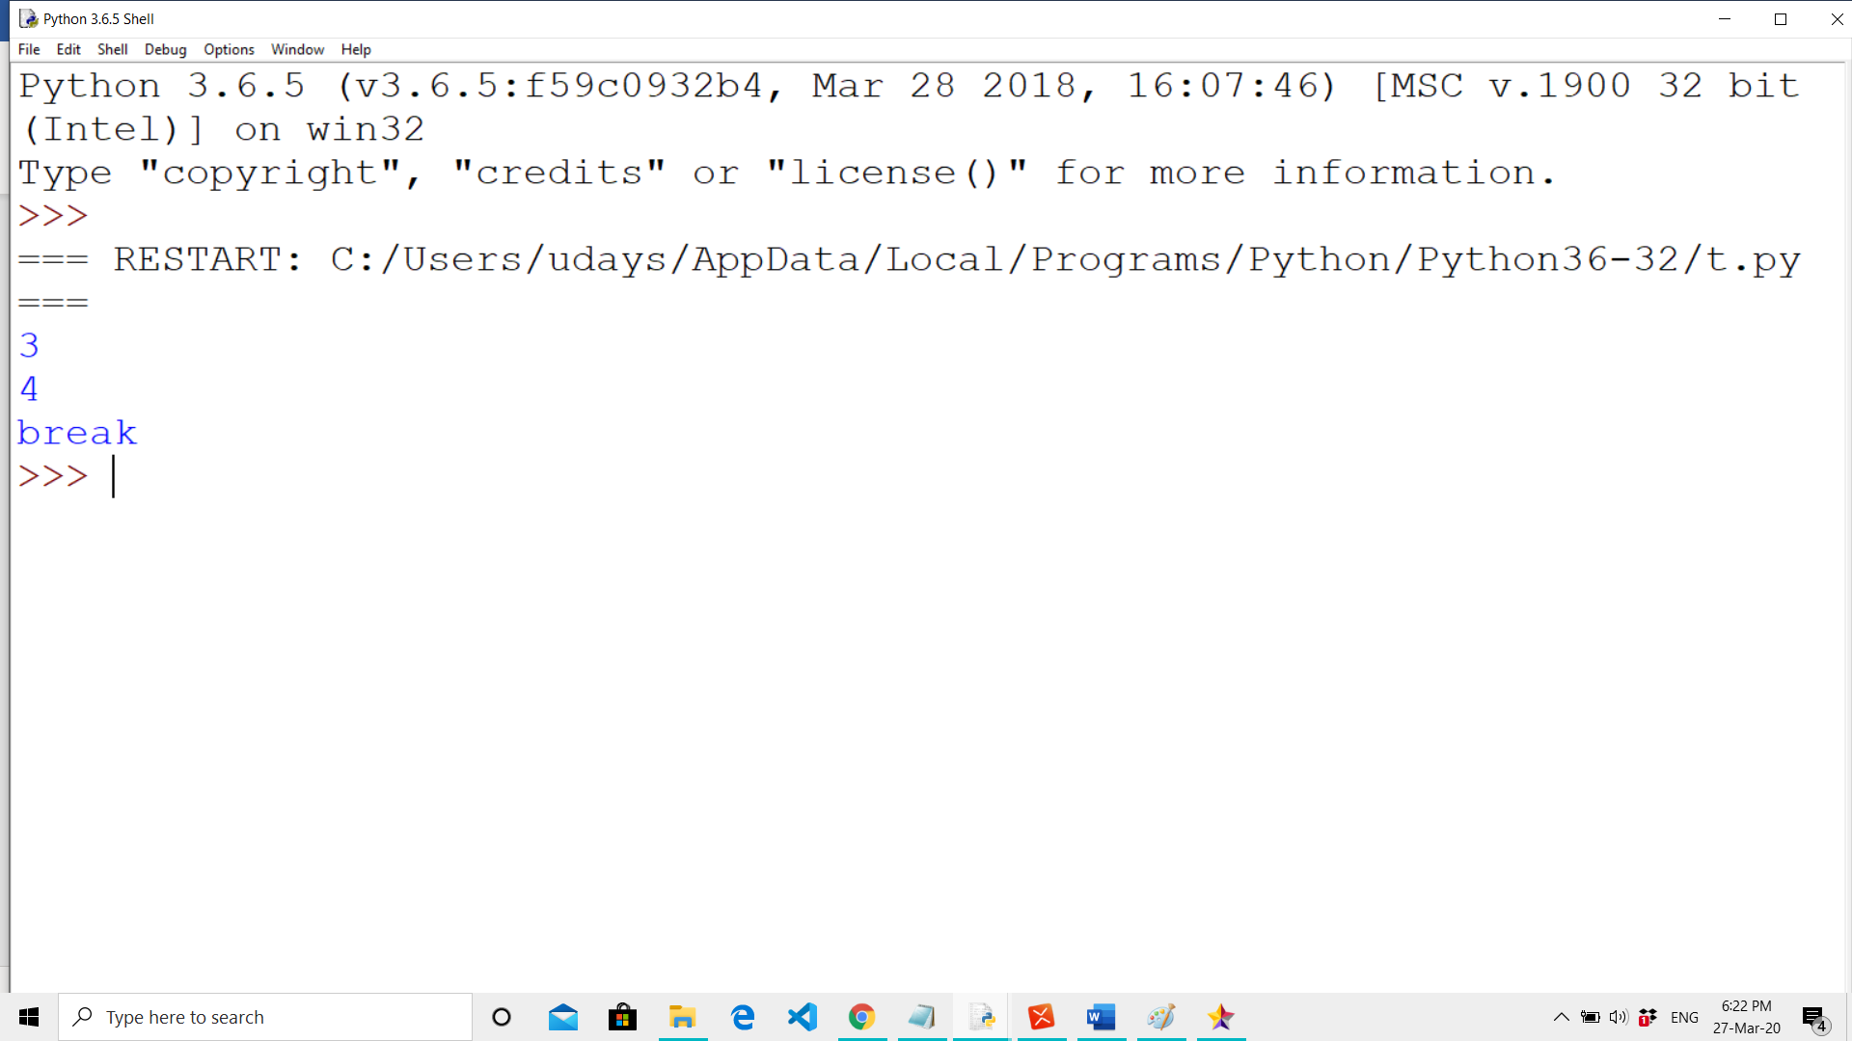
BREAK STATEMENT
This statement is used to terminate the loop.
EXAMPLE
OUTPUT :
OUTPUT:

Slide 58
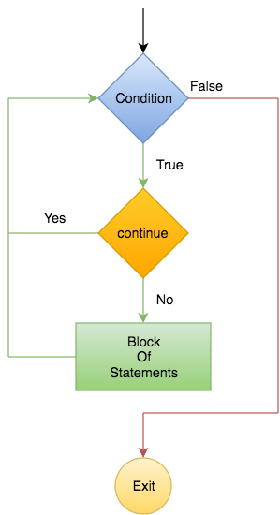
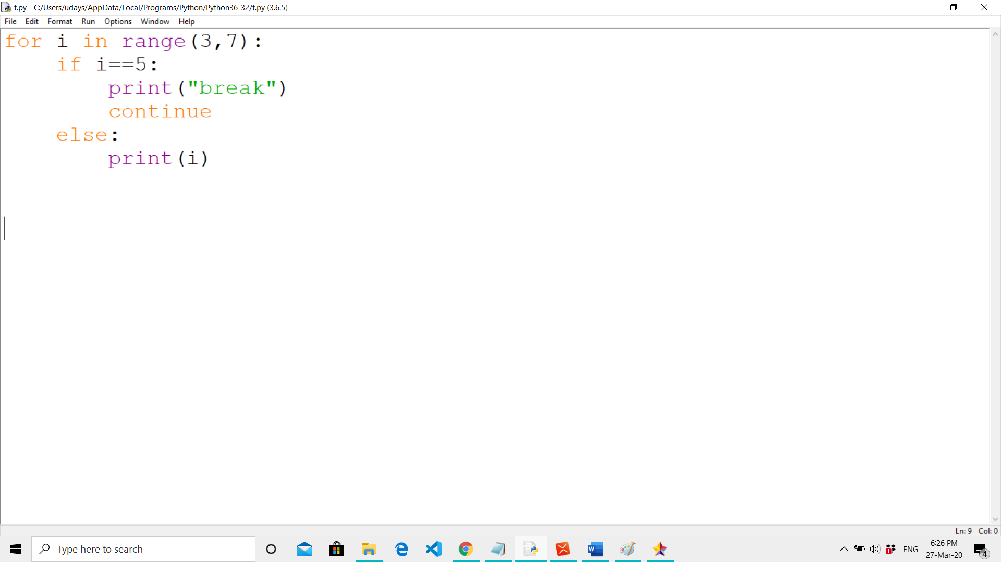

CONTINUE STATEMENT
This statement is used to skip the iteration.
EXAMPLE
OUTPUT :
OUTPUT:

Slide 59

PASS STATEMENT
This statement does nothing.
We use pass statement when you create a method that you don’t want to implement yet.
EXAMPLE
OUTPUT:

Slide 60




WHILE WITH ELSE CLAUSE
The else clause is only executed when your while condition becomes false. If you break out of the loop, or if an exception is raised, it won’t be executed.
OUTPUT :
OUTPUT :
OUTPUT:

Slide 61



FOR WITH ELSE CLAUSE
The else clause is only executed when the for condition becomes false. If you break out of the loop, or if an exception is raised, it won’t be executed.
OUTPUT :
OUTPUT :
OUTPUT:

Slide 62
FUNCTIONS IN PYTHON
A function is a set of statements that take inputs, do some specific computation and produces output.
These set of statements can be used anywhere just by calling its name and we call this as reusability.
10 | ‘Python’ | 42.31 | True | 20

Slide 63
TYPES OF FUNCTIONS
PYTHON BUILT-IN FUNCTIONS
PYTHON USER-DEFINED FUNCTIONS
PYTHON RECURSION FUNCTIONS
PYTHON LAMBDA FUNCTIONS

Slide 64
PYTHON BUILT-IN FUNCTIONS
Function | Description
abs() | Returns the absolute value of a number
all() | Returns True if all items in an iterable object are true
any() | Returns True if any item in an iterable object is true
ascii() | Returns a readable version of an object. Replaces none-ascii characters with escape character
bin() | Returns the binary version of a number
bool() | Returns the boolean value of the specified object
bytearray() | Returns an array of bytes
bytes() | Returns a bytes object
callable() | Returns True if the specified object is callable, otherwise False
chr() | Returns a character from the specified Unicode code.
zip() | Returns an iterator, from two or more iterators

Slide 65
PYTHON BUILT-IN FUNCTIONS
Function | Description
classmethod() | Converts a method into a class method
compile() | Returns the specified source as an object, ready to be executed
complex() | Returns a complex number
delattr() | Deletes the specified attribute (property or method) from the specified object
dict() | Returns a dictionary (Array)
dir() | Returns a list of the specified object's properties and methods
divmod() | Returns the quotient and the remainder when argument1 is divided by argument2
enumerate() | Takes a collection (e.g. a tuple) and returns it as an enumerate object
eval() | Evaluates and executes an expression
exec() | Executes the specified code (or object)
filter() | Use a filter function to exclude items in an iterable object

Slide 66
PYTHON BUILT-IN FUNCTIONS
Function | Description
float() | Returns a floating point number
format() | Formats a specified value
frozenset() | Returns a frozenset object
getattr() | Returns the value of the specified attribute (property or method)
globals() | Returns the current global symbol table as a dictionary
hasattr() | Returns True if the specified object has the specified attribute (property/method)
hash() | Returns the hash value of a specified object
help() | Executes the built-in help system
hex() | Converts a number into a hexadecimal value
id() | Returns the id of an object
input() | Allowing user input

Slide 67
PYTHON BUILT-IN FUNCTIONS
Function | Description
int() | Returns an integer number
isinstance() | Returns True if a specified object is an instance of a specified object
issubclass() | Returns True if a specified class is a subclass of a specified object
iter() | Returns an iterator object
len() | Returns the length of an object
list() | Returns a list
locals() | Returns an updated dictionary of the current local symbol table
map() | Returns the specified iterator with the specified function applied to each item
max() | Returns the largest item in an iterable
memoryview() | Returns a memory view object
min() | Returns the smallest item in an iterable

Slide 68
PYTHON BUILT-IN FUNCTIONS
Function | Description
next() | Returns the next item in an iterable
object() | Returns a new object
oct() | Converts a number into an octal
open() | Opens a file and returns a file object
ord() | Convert an integer representing the Unicode of the specified character
pow() | Returns the value of x to the power of y
print() | Prints to the standard output device
property() | Gets, sets, deletes a property
range() | Returns a sequence of numbers, starting from 0 and increments by 1 (by default)
repr() | Returns a readable version of an object
reversed() | Returns a reversed iterator

Slide 69
PYTHON BUILT-IN FUNCTIONS
Function | Description
round() | Rounds a numbers
set() | Returns a new set object
setattr() | Sets an attribute (property/method) of an object
slice() | Returns a slice object
sorted() | Returns a sorted list
@staticmethod() | Converts a method into a static method
str() | Returns a string object
sum() | Sums the items of an iterator
super() | Returns an object that represents the parent class
tuple() | Returns a tuple
type() | Returns the type of an object

Slide 70
USER-DEFINED FUNCTIONS
Def()
Functions that we define ourselves to do certain specific task are referred as user-defined functions.
User-defined functions can be defined using def keyword.

Slide 71


DEFINING A FUNCTION

Slide 72

PASS BY VALUE OR PASS BY REFERENCE
All parameters (arguments) in the Python language are passed by reference. It means if you change what a parameter refers to within a function, the change also reflects in the calling function.

Slide 73


THE RETURN STATEMENT
A value can be returned from the function using return keyword.

Slide 74
FUNCTION ARGUMENTS
Default Arguments
Required Arguments
Keyword Arguments
Variable number of Arguments

Slide 75

DEFAULT ARGUMENTS
Default values are set to indicate that the function argument will take that value if no argument value is passed during function call.
The default value is assigned by using assignment (=) operator.

Slide 76

REQURIED ARGUMENTS
Required arguments are the mandatory arguments of a function. These argument values must be passed in correct number and order during function call.

Slide 77

KEYWORD ARGUMENTS
Keyword arguments are relevant for python function calls.
The keywords are mentioned during function call along with their corresponding values.
These keywords are mapped with the function arguments.

Slide 78

VARIABLE NUMBER OF ARGUMENTS
This is very useful when we do not know the exact number of arguments to be passed to a function.

Slide 79

RECURSIVE FUNCTIONS
Recursion is a way of programming or coding a problem, in which a function calls itself one or more times in its body.

Slide 80

ANONYMOUS FUNCTIONS
These functions are called anonymous because they are not declared in the standard manner by using the def keyword.
You can use the lambda keyword to create small anonymous functions.

Slide 81
INTRODUCTION TO LIST
LIST IS AN ORDERED COLLECTIONS OF ITEMS.
ITEM COULD BE OF ANY PYTHON DATATYPE ( NUMBER, STRINGS, TUPLE, DICTIONARY, LIST ).
10 | ‘Python’ | 42.31 | True | 20

Slide 82

CREATING A LIST
Alist = [] #empty list
Alist = [12, 56.3, 'Python', (5,7,3)]
Using split() or map()

Slide 83


ACCESSING ELEMENTS IN A LIST
0 | 1 | 2 | 3 | 4
10 | ‘Python’ | 42.31 | True | 20
-5 | -4 | -3 | -2 | -1
ITEMS IN LIST CAN BE ACCESSED BY USING INDEXING.
NEGATIVE INDEXING IS USED TO ACCESS THE ITEMS OF THE LIST FROM THE LAST.

Slide 84



MODIFY AND DELETE A LIST
List is a mutable datatype. Hence List can be modified by using its index value.
List can be deleted using del keyword
Here the value at 0 index is changed to 43.7

Slide 85



LIST METHODS
append():
Add an element to the end of the list
extend():
Add all elements of a list to another list
insert():
Insert an item at the defined index

Slide 86



LIST METHODS
remove():
Removes an item by its value from the list.
pop():
Removes the last item from the list or removes an item by its index from the list.
clear():
Removes all items from the list

Slide 87

LIST METHODS
index():
Returns the index of the first matched item.
count():
Returns the count of number of items passed as an argument.
copy():
Returns a copy of the list

Slide 88
LIST METHODS
sort():
Sort items in a list in ascending order
reverse():
Reverse the order of items in the list

Slide 89

LIST BUILT-IN FUNCTIONS
sum():
Sums up the numbers in the list
max():
Return maximum element of given list
min():
Return minimum element of given list

Slide 90
LIST BUILT-IN FUNCTIONS
all():
Returns true if all element are true or if list is empty
any():
Return true if any element of the list is true. If list is empty, return false
len():
Returns length of the list or size of the list

Slide 91


OPERATIONS ON LIST
CONCATENATION OF LIST (+)
REPETITION OF LIST (*)
MEMBERSHIP ON LIST (in, not in)

Slide 92


SLICING A LIST
Slice operation is used to print specific range of elements from the list.
Slice operation is performed on lists with the use of colon(:)
list_name[starting_index : ending_index]
list_name[starting_index : ending_index : steps]

Slide 93

SLICING A LIST
L[:] – prints all the elements from the list.
L[2:] – prints all the elements from the list starting from index 2
L[:5] – prints all the elements from the list till the ending index 4
L[2:6] – prints the elements from the list from index 2 till index 5
L[-4:-2] – prints the elements from the list from index -4 till index -3

Slide 94

SLICING A LIST
L[::2] – prints all the elements from the list with step 2 (index+2 element) from the beginning.
L[::-1] – prints all the elements from the list with step 1 (index+1) from the last.
L[1:6:3] – prints all the elements from the list from index 1 till index 5 with steps 3.

Slide 95

NESTED LIST
LIST INSIDE ANOTHER LIST IS NESTED LIST.
NESTED LIST IS ALSO CALLED AS MULTIDIMENSIONAL LIST.

Slide 96


LIST COMPREHENSION
List comprehension is an elegant way to define and create list in python.
LIST COMPREHENSION
OUTPUT EXPRESSION
INPUT SEQUENCE
VARIABLE
x ** 2 is output expression,
range (1, 11) is input sequence,
x is variable and if x % 2 == 0 is predicate part.

Slide 97
INTRODUCTION TO TUPLES
Tuple is similar to List in python language, both are sequential, index-based data structure.
TUPLE | LIST
Tuple is immutable datatype. | List is mutable datatype.
Tuple uses parenthesis. | List uses square brackets.

Slide 98

CREATING A TUPLE
ATuple = () #empty tuple
ATuple = (1,2,3)
Using split() or map()

Slide 99

ACCESSING ELEMENTS IN A TUPLE
0 | 1 | 2 | 3 | 4
10 | ‘Python’ | 42.31 | True | 20
-5 | -4 | -3 | -2 | -1
ITEMS IN TUPLE CAN BE ACCESSED BY USING INDEXING.
NEGATIVE INDEXING IS USED TO ACCESS THE ITEMS OF THE TUPLE FROM THE LAST.

Slide 100


MODIFY AND DELETE A TUPLE
Tuple is immutable data type; hence the values cannot be changed in the tuple.
Tuple can be deleted by using del keyword.

Slide 101

TUPLE METHODS
index():
Returns the index of the first matched item.
count():
Returns the count of number of items passed as an argument.

Slide 102

TUPLE BUILT-IN FUNCTIONS
sum():
Sums up the numbers in the tuple.
max():
Return maximum element of given tuple.
min():
Return minimum element of given tuple.

Slide 103
TUPLE BUILT-IN FUNCTIONS
all():
Returns true if all element are true or if tuple is empty
any():
Return true if any element of the tuple is true. If tuple is empty, return false
len():
Returns length of the tuple or size of the tuple

Slide 104

OPERATIONS ON TUPLE
CONCATENATION OF TUPLE (+)
REPETITION OF TUPLE (*)
MEMBERSHIP OPERATORS ON TUPLE
(in, not in)

Slide 105
SLICING A TUPLE
Slice operation is used to print specific range of elements from the tuple.
Slice operation is performed on Tuples with the use of colon(:)
tuple_name[starting_index : ending_index]
tuple_name[starting_index : ending_index : steps]

Slide 106

SLICING A TUPLE
T[:] – prints all the elements from the tuple.
T[2:] – prints all the elements from the tuple starting from index 2
T[:5] – prints all the elements from the tuple till the ending index 4
T[2:6] – prints the elements from the tuple from index 2 till index 5
T[-4:-2] – prints the elements from the tuple from index -4 till index -3

Slide 107

SLICING A TUPLE
T[::2] – prints all the elements from the tuple with step 2 (index+2 element) from the beginning.
T[::-1] – prints all the elements from the tuple with step 1 (index+1) from the last.
T[1:6:3] – prints all the elements from the tuple from index 1 till index 5 with steps 3.

Slide 108

NESTED TUPLE
TUPLE INSIDE ANOTHER TUPLE IS NESTED TUPLE.

Slide 109

TUPLE COMPREHENSION
There is no tuple comprehension in Python.
We make use of tuple() to type convert the list comprehension.
TUPLE COMPREHENSION
OUTPUT EXPRESSION
INPUT SEQUENCE
VARIABLE
i*i is output expression,
range (1, 5) is input sequence,
i is variable.
Tuple comprehension can be done by type converting the expression into tuple datatype.

Slide 110






IMPORTANCE OF LISTS AND TUPLES

Slide 111

LET’S START CODING

Slide 112
PROBLEM STATEMENT 1
Take two different lists, merge them and print a new sorted list.
Input Format:
Read two lists, a and b.
Output Format:
Print the sorted list after merging the given two lists.
Test cases:
Sample Input | Sample Output
1 2 3 6 0 5 7 | [0, 1, 2, 3, 4, 5, 6, 7]
1 -5 69 74 25 34 -3 5 | [-3, -5, 1, 25, 34, 5, 69, 74]

Slide 113

CODE

Slide 114
PROBLEM STATEMENT 2
Input a list and sort the elements in the list based on its length.
Input Format:
Read the list
Output Format:
Sort the list according to the length of the elements in the list.
Test Cases:
Sample Input | Sample Output
hi 1 425 2104 | ['1', 'hi', '425', '2104']
47 5102 0 abc | ['0', '47', 'abc', '5102']

Slide 115

CODE

Slide 116
PROBLEM STATEMENT 3
Read a list and swap first element and last element in the list.
Input Format:
Read a list.
Output Format:
Print the list after swapping first value and last value in the list.
Test Cases:
Sample Input | Sample Output
hello 12 423 53 0 | ['0', '12', '423', '53', 'hello']
4 a 2 3 6 x | ['x', 'a', '2', '3', '6', '4']

Slide 117

CODE

Slide 118
PROBLEM STATEMENT 4
Print the list after deleting the duplicate elements in it.
Input Format:
Read a list.
Output Format:
Print the list after deleting the duplicate elements in it.
Test Cases:
Sample Input | Sample Output
hello 12 423 53 0 | ['0', '12', '423', '53', 'hello']
4 a 2 3 6 x | ['x', 'a', '2', '3', '6', '4']

Slide 119

CODE

Slide 120
PROBLEM STATEMENT 5
Print the elements in the list which has occurred odd number of times.
Input Format:
Read a list.
Output Format:
Print the list elements which has occurred odd number of times.
Test Cases:
Sample Input | Sample Output
4 7 5 2 2 5 5 7 3 7 4 | ['7', '5', '3']
2 5 6 3 5 6 2 2 | ['2', '3']

Slide 121

CODE

Slide 122
PROBLEM STATEMENT 7
Read a list and print sum of three minimum elements in the list.
Input Format:
Read a list.
Output Format:
Print the sum of three minimum elements in the list.
Test Cases:
Sample Input | Sample Output
4 2 3 1 5 | 6
4 0 1 2 5 68 | 3

Slide 123

CODE

Slide 124
PROBLEM STATEMENT 8
Segregate the given list as even elements first in descending order and then odd elements next in ascending order.
Input Format:
Read a list.
Output Format:
Print the segregated list.
Test Cases:
Sample Input | Sample Output
5 3 2 4 6 7 | [6, 4, 2, 3, 5, 7]
7 5 4 8 1 2 3 6 0 | [8, 6, 4, 2, 0, 1, 3, 5, 7]

Slide 125

CODE

Slide 126
PROBLEM STATEMENT 9
Given lists in a list, find the maximum sum of elements of list in a list of lists and print its index.
Input Format:
Read a list of lists.
Output Format:
Print the maximum sum of list index.
Test Cases:
Sample Input | Sample Output
3 4 5 2 1 2 3 6 7 4 | 2
2 1 2 4 5 4 2 1 | 1

Slide 127

CODE

Slide 128
PROBLEM STATEMENT 10
Write a python program to remove an element from specified index.
Input Format:
Read a tuple and an index.
Output Format:
Remove the element from specified index and print the tuple.
Test Cases:
Sample Input | Sample Output
1,2,3,4,5 3 | ('1', '2', '3', '5')
18,11,5,6,10 0 | ('11', '5', '6', '10')

Slide 129

CODE

Slide 130
PROBLEM STATEMENT 11
Write a Python program to reverse a tuple.
Input Format:
Read a tuple.
Output Format:
Print the reverse of the tuple.
Test Cases:
Sample Input | Sample Output
1,2,3,4,5 | ('5', '4', '3', '2', ‘1')
10,2,5,9 | ('9', '5', '2', '10')

Slide 131

CODE

Slide 132
PROBLEM STATEMENT 13
Write a Python program to count the elements in a list until an element is a tuple.
Input Format:
Read a list.
Output Format:
Print count of list until tuple is found.
Test Cases:
Sample Input | Sample Output
[1,2,3,4,5,(1,2,3),1,2] | 5
[1,2,(4,5,6)] | 2

Slide 133

CODE

Slide 134
PROBLEM STATEMENT 14
Write a Python program to find the index of an item of a tuple.
Input Format:
Read a tuple and an element.
Output Format:
Print the index of given element.
Test Cases:
Sample Input | Sample Output
1,2,3,4,5 5 | 4
9,4,1,2,3 1 | 2

Slide 135

CODE

Slide 136
INTRODUCTION
A dictionary is a collection which is unordered, changeable and indexed.
In Python dictionaries are written with curly brackets, and they have keys and values.

Slide 137

CREATING A DICTIONARY
Values can be of any datatype, and can be duplicated.
Whereas keys cannot be repeated and must be immutable.

Slide 138



ACCESSING ELEMENTS IN A DICTIONARY

Slide 139



MODIFY AND DELETE A DICTIONARY
Only values in dictionary can be changed but keys should be immutable.
Adding an element to dictionary.

Slide 140

DICTIONARY METHODS
get():
It is a conventional method to access a value for a key.
update():
Adds dictionary dict2’s key-values pairs to dict
copy():
They copy() method returns a shallow copy of the dictionary.

Slide 141

DICTIONARY METHODS
pop():
Removes and returns an element from a dictionary having the given key.
popitem():
Removes the arbitrary key-value pair from the dictionary and returns it as tuple.
clear():
The clear() method removes all items from the dictionary.

Slide 142

DICTIONARY METHODS
keys():
Returns list of dictionary dict’s keys
values():
returns a list of all the values available in a given dictionary.
items():
Returns a list of dict’s (key, value) tuple pairs

Slide 143

NESTED DICTIONARY
DICTIONARY INSIDE ANOTHER DICTIONARY IS NESTED DICTIONARY.

Slide 144

WHAT IS THE OUTPUT
Select all correct ways to empty the following dictionary
del student
del student[0:2]
student.clear()
C

Slide 145

DICTIONARY COMPREHENSION
Dictionary comprehension is a method for transforming one dictionary into another dictionary.

Slide 146
SETS

Slide 147
INTRODUCTION
A Set is an unordered collection data type that is iterable, mutable and has no duplicate elements.
Sets can be used to perform mathematical set operations like union, intersection, symmetric difference etc.

Slide 148

CREATING A SET

Slide 149

ACCESSING ELEMENTS IN A SET
Sets are unordered datatype. Hence, there is no indexing in sets.

Slide 150

MODIFY AND DELETE A SET
Elements in the sets cannot be accessed using indexing and hence modifying the set is not possible.
A set can be deleted by using del keyword.

Slide 151
GUESS THE OUTPUT ?
Which of the following Python code will create a set?
(i) set1=set((0,9,0)) (ii) set1=set([0,2,9]) (iii) set1={}
A. iii B. i and ii C. ii, iii D. All of the above
D

Slide 152

SET METHODS
add():
Adds an element to the set.
update():
Updates the set with the union of itself and others.
copy():
Returns a copy of the set
clear():
Removes all elements from the set.

Slide 153

SET METHODS
remove():
Removes an element from the set. If the element is not a member, raise a KeyError.
pop():
Removes and returns an arbitrary set element. Raise KeyError if the set is empty.
discard():
Removes an element from the set if it is a member. (Do nothing if the element is not in set)

Slide 154


SET METHODS
union():
Returns the union of sets in a new set.
intersection():
Returns the intersection of two sets as a new set.
intersection_update():
Updates the set with the intersection of itself and another.

Slide 155


SET METHODS
difference():
Returns the difference of two or more sets as a new set.
difference_update():
Removes all elements of another set from this set.

Slide 156
SET METHODS
symmetric_difference():
Returns the symmetric difference of two sets as a new set.
symmetric_difference_update():
Updates a set with the symmetric difference of itself and another

Slide 157

SET METHODS
isdisjoint():
Returns True if two sets have a null intersection.
issubset():
Returns True if another set contains this set.
issuperset():
Returns True if this set contains another set.

Slide 158

MATCH THE METHOD WITH ITS DESCRIPTION
METHOD
add():
discard():
pop():
union():
intersection():
intersection_update():
isdisjoint():
issubset():
issuperset():
DESCRIPTION
Removes and returns an arbitrary set element. Raise KeyError if the set is empty.
Returns the intersection of two sets as a new set.
Adds an element to the set.
Returns True if another set contains this set.
Removes an element from the set if it is a member. (Do nothing if the element is not in set)
Returns the union of sets in a new set.
Updates the set with the intersection of itself and another.
Returns True if this set contains another set.
Returns True if two sets have a null intersection.

Slide 159
MATCH THE METHOD WITH ITS DESCRIPTION
METHOD
add():
discard():
pop():
union():
intersection():
intersection_update():
isdisjoint():
issubset():
issuperset():
DESCRIPTION
Removes and returns an arbitrary set element. Raise KeyError if the set is empty.
Returns the intersection of two sets as a new set.
Adds an element to the set.
Returns True if another set contains this set.
Removes an element from the set if it is a member. (Do nothing if the element is not in set)
Returns the union of sets in a new set.
Updates the set with the intersection of itself and another.
Returns True if this set contains another set.
Returns True if two sets have a null intersection.

Slide 160

SET BUILT-IN FUNCTIONS
sum():
Returns the sum of all elements in the set.
max():
Return the largest item in the set.
min():
Return the smallest item in the set.
len():
Return the length (the number of items) in the set.

Slide 161

SET BUILT-IN FUNCTIONS
all():
Return True if all elements of the set are true (or if the set is empty).
any():
Return True if any element of the set is true. If the set is empty, return False.
sorted():
Return a new sorted list from elements in the set(does not sort the set itself).

Slide 162
GUESS THE ANSWER..?
STATEMENTS
S = {14, 152, 23, 10, 8} max(S)
S = {4, 71, 23, 2, 47, 60} min(S)
S = {1, 2, 3, 4, 5} sum(S)
S = {0, 0, 1, 7, 6, 5} all(S)
S = {1, 2, 7, 0, 11, 6} any(S)
S ={1,2,3,4,5} len(S)
RESULT
True
152
2
15
5
False

Slide 163
GUESS THE ANSWER..?
STATEMENTS
S = {14, 152, 23, 10, 8} max(S)
S = {4, 71, 23, 2, 47, 60} min(S)
S = {1, 2, 3, 4, 5} sum(S)
S = {0, 0, 1, 7, 6, 5} all(S)
S = {1, 2, 7, 0, 11, 6} any(S)
S ={1,2,3,4,5} len(S)
RESULT
True
152
2
15
5
False

Slide 164

OPERATIONS ON SET
MEMBERSHIP ON TUPLE (in, not in)
EQUAL(==) , NOT EQUAL(!=)
SUBSET (<=), PROPER SUBSET(<)
SUPERSET(>=), PROPER SUPERSET(>)
UNION(|), INTERSECTION(&)
DIFFERENCE(-), SYMMETRIC_DIFFERENCE(^)

Slide 165
LET’S START CODING

Slide 166
PROBLEM STATEMENT 1
Write a Python program to add a key to a dictionary.
Input Format:
Read a dictionary and keys to be added.
Output Format:
Print the updated dictionary.
Test Cases:
Test cases:
Sample Input | Sample Output
1 2 2 3 3 4 4 5 | {'1':'2','2':'3','3':'4','4':'5'}
1 2 5 1 3 6 | {'1':'2','5':'1','3':'6'}

Slide 167

CODE

Slide 168
PROBLEM STATEMENT 2
Write a Python program to check whether a given key already exists in a dictionary.
Input Format:
Input a dictionary and key to check.
Output Format:
Print whether key is present in dictionary.
Test Cases:
Sample Input | Sample Output
{1: 10, 2: 20, 3: 30, 4: 40, 5: 50, 6: 60} 2 | Key is present in the dictionary
{1: 1, 2: 2, 3: 3} 4 | Key is not present in the dictionary

Slide 169

CODE

Slide 170
PROBLEM STATEMENT 3
Write a Python program to generate and print a dictionary that contains a number (between 1 and n) in the form (x, x*x)..
Input Format:
Read a number n.
Output Format:
Print the dictionary.
Test Cases:
Sample Input | Sample Output
3 | {1:1,2:4,3:9}
5 | {1:1,2:4,3:9,4:16,5:25}

Slide 171

CODE

Slide 172
PROBLEM STATEMENT 4
Write a Python program to merge two Python dictionaries.
Input Format:
Read two dictionaries.
Output Format:
Print the merged dictionaries.
Test Cases:
Sample Input | Sample Output
{1:2,3:4} {5:6} | {1:2,3:4,5:6}
{9:5,3:4} {8:5,6:7} | {9:5,3:4,8:5,6:7}

Slide 173

CODE

Slide 174
PROBLEM STATEMENT 5
Write a Python program to remove a key from a dictionary.
Input Format:
Read dictionary and key to remove.
Output Format:
Print the updated dictionary.
Test Cases:
Sample Input | Sample Output
{9:5,3:4,8:5,6:7} 3 | {9:5,8:5,6:7}
{1:2,3:4,5:6} 1 | {3:4,5:6}

Slide 175

CODE

Slide 176
PROBLEM STATEMENT 6
Write a Python program to map two lists into a dictionary.
Input Format:
Read two lists.
Output Format:
Print the dictionary.
Test Cases:
Sample Input | Sample Output
1 2 3 2 3 5 | {1:2,2:3,3:4}
10 5 6 9 2 10 | {10:9,5:2,6:10}

Slide 177

CODE

Slide 178
PROBLEM STATEMENT 7
Write a Python program to combine two dictionary adding values for common keys.
Input Format:
Read two dictionaries.
Output Format:
Print the new dictionary.
Test Cases:
Sample Input | Sample Output
{'a': 100, 'b': 200, 'c':300} {'a': 300, 'b': 200, 'd':400} | {'b': 400, 'd': 400, 'a': 400, 'c': 300}
{'a’: 200, 'b': 200, 'c':300} {'a': 300, 'b': 200, 'd':400} | {'b': 400, 'd': 400, 'a': 400, 'c': 300}

Slide 179

CODE

Slide 180
PROBLEM STATEMENT 8
Write a Python program to create set difference.
Input Format:
Read two sets.
Output Format:
Print the set difference.
Test Cases:
Sample Input | Sample Output
1 2 3 4 2 3 5 | {'1','4'}
10 5 6 9 2 10 5 | {'6'}

Slide 181

CODE

Slide 182
PROBLEM STATEMENT 9
Write a Python program to create union of set.
Input Format:
Read two sets.
Output Format:
Print the union of set.
Test Cases:
Sample Input | Sample Output
1 2 3 4 2 3 5 | {'1','4','2','5','3'}
10 5 6 9 2 10 5 | {'6','9','2','10','5'}

Slide 183

CODE

Slide 184
PROBLEM STATEMENT 10
Write a Python program to create intersection of set.
Input Format:
Read two sets.
Output Format:
Print the intersection of set.
Test Cases:
Sample Input | Sample Output
1 2 3 4 2 3 5 | {'2','3'}
10 5 6 9 2 10 5 | {'10','5'}

Slide 185

CODE

Slide 186
PROBLEM STATEMENT 11
Write a Python program to find the length of a set.
Input Format:
Read a set.
Output Format:
Print the length of set.
Test Cases:
Sample Input | Sample Output
1 2 3 4 5 | 5
2 5 8 | 3

Slide 187

CODE

Slide 188
PROBLEM STATEMENT 12
Write a Python program to find maximum and the minimum value in a set.
Input Format:
Read a set.
Output Format:
Print the maximum and minimum value of set.
Test Cases:
Sample Input | Sample Output
9 7 5 1 3 | Max:9 Min:1
4 6 1 0 | Max:6 Min:0

Slide 189

CODE

Slide 190
PROBLEM STATEMENT 13
Write a Python program to create a symmetric difference.
Input Format:
Read two sets.
Output Format:
Print the symmetric difference.
Test Cases:
Sample Input | Sample Output
1 2 3 2 4 1 | {'3','4'}
8 5 2 5 4 3 | {'3','2','8','4'}

Slide 191

CODE

Slide 192
INTRODUCTION
A string is a sequence of characters..
String literals in python are surrounded by either single quotation marks, or double quotation marks.
h | e | l | l | o

Slide 193


CREATING A STRING
Strings can be created by enclosing characters inside a single quote or double-quotes.
Anything given as input is basically considered as string.

Slide 194



ACCESSING ELEMENTS IN A STRING
Like list, string elements can also be accessed using indexing.
indexing
0 | 1 | 2 | 3 | 4 | 5
P | Y | T | H | O | N
-6 | -5 | -4 | -3 | -2 | -1
Negative
indexing

Slide 195

MODIFY A STRING
Strings are immutable, hence elements of a String cannot be changed once it has been assigned.
Only new strings can be reassigned to the same name.

Slide 196

DELETE A STRING
We can directly delete a string using del keyword.
Delete a string using index is not possible.

Slide 197

STRING METHODS AND FUNCTIONS
String.ascii_letters:
Concatenation of the ascii_lowercase and ascii_uppercase constants.
string.ascii_lowercase:
Concatenation of lowercase letters
string.ascii_uppercase:
Concatenation of uppercase letters
string.punctuation:
ASCII characters having punctuation characters.

Slide 198
STRING METHODS AND FUNCTIONS
string.digits:
Digit in strings
string.hexdigits:
Hexadigit in strings
string.octdigits:
Octadigit in a string

Slide 199

STRING METHODS AND FUNCTIONS
string.endswith():
Returns True if a string ends with the given suffix otherwise returns False
string.startswith():
Returns True if a string starts with the given prefix otherwise returns False
replace():
returns a copy of the string where all occurrences of a substring is replaced with another substring.

Slide 200
STRING METHODS AND FUNCTIONS
string.isdigit():
Returns “True” if all characters in the string are digits, Otherwise, It returns “False”.
string.isalpha():
Returns “True” if all characters in the string are alphabets, Otherwise, It returns “False”.
string.isdecimal():
Returns true if all characters in a string are decimal.

Slide 201
STRING METHODS AND FUNCTIONS
string.isalnum():
Returns true if all the characters in a given string are alphanumeric.
string.istitle():
Returns True if the string is a titlecased string

Slide 202
STRING METHODS AND FUNCTIONS
string.upper():
Returns the string with all uppercases.
string.lower():
Returns the string with all lowercases.
string.swapcase():
Method converts all uppercase characters to lowercase and vice versa of the given string, and returns it

Slide 203

STRING METHODS AND FUNCTIONS
string.partition:
splits the string at the first occurrence of the separator and returns a tuple.
string.index:
Returns the position of the first occurrence of substring in a string.
string.rindex:
Returns the highest index of the substring inside the string if substring is found.
string.splitlines:
Returns a list of lines in the string.

Slide 204
STRING METHODS AND FUNCTIONS
string.capitalize:
Return a word with its first character capitalized.
string.find:
Return the lowest index in a sub string.
string.rfind:
find the highest index.
string.count:
Return the number of (non-overlapping) occurrences of substring sub in string

Slide 205
STRING METHODS AND FUNCTIONS
len():
Returns the length of the string.
max():
Returns the highest alphabetical character in a string.
min():
Returns the minimum alphabetical character in a string.

Slide 206

SLICING A STRING
S[:] – prints all the elements from the string.
S[2:] – prints all the elements from the string starting from index 2
S[:5] – prints all the elements from the string till the ending index 4
S[2:6] – prints the elements from the string from index 2 till index 5
S[-4:-2] – prints the elements from the string from index -4 till index -3

Slide 207
SLICING A STRING
S[::2] – prints all the elements from the string with step 2 (index+2 element) from the beginning.
S[::-1] – prints all the elements from the string with step 1 (index+1) from the last.
S[1:6:3] – prints all the elements from the string from index 1 till index 5 with steps 3.

Slide 208

GUESS THE OUTPUT ?
Guess the correct output of the following String operations
A)WelcomeWelcome
B)TypeError: unsupported operand type(s) for * or pow(): ‘str’ and ‘int’
a

Slide 209

GUESS THE OUTPUT ?
Select the correct output of the following String operations
A)Welcome Coder
B)WelcomCoder
C)Welcom Coder
D)WelcomeCoder
c

Slide 210

GUESS THE OUTPUT ?
What is the output of the following code
A)False
True
B)False
False
C)True
False
a

Slide 211
MATCH THE METHOD WITH ITS DESCRIPTION
DESCRIPTION
returns a copy of the string where all occurrences of a substring is replaced with another substring.
Returns True if the string is a titlecased string
Concatenation of the ascii_lowercase and ascii_uppercase constants.
splits the string at the first occurrence of the separator and returns a tuple.
ASCII characters having punctuation characters.
Returns true if all characters in a string are decimal.
Returns true if all the characters in a given string are alphanumeric.
Return a word with its first character capitalized.
Returns the highest index of the substring inside the string if substring is found.
METHOD
String.ascii_letters:
string.punctuation:
replace():
string.isdecimal():
string.istitle:
string.isalnum:
string.rindex:
string.partition:
string.capitalize:

Slide 212
MATCH THE METHOD WITH ITS DESCRIPTION
DESCRIPTION
returns a copy of the string where all occurrences of a substring is replaced with another substring.
Returns True if the string is a titlecased string
Concatenation of the ascii_lowercase and ascii_uppercase constants.
splits the string at the first occurrence of the separator and returns a tuple.
ASCII characters having punctuation characters.
Returns true if all characters in a string are decimal.
Returns true if all the characters in a given string are alphanumeric.
Return a word with its first character capitalized.
Returns the highest index of the substring inside the string if substring is found.
METHOD
String.ascii_letters:
string.punctuation:
replace():
string.isdecimal():
string.istitle:
string.isalnum:
string.rindex:
string.partition:
string.capitalize:

Slide 213
LET’S START CODING

Slide 214
PROBLEM STATEMENT 1
Write a Python program to calculate the length of a string.
Input Format:
Read a string.
Output Format:
Print the length of a string.
Test cases:
Sample Input | Sample Output
coder123 | 8
programming | 11

Slide 215

CODE

Slide 216
PROBLEM STATEMENT 2
Write a Python script that takes input from the user and displays that input back in upper and lower cases.
Input Format:
Read a string
Output Format:
Print the string in both upper and lower case.
Test Cases:
Sample Input | Sample Output
talentio | Your input in upper case TALENTIO Your input in lower case talentio
python | Your input in upper case PYTHON Your input in lower case python

Slide 217

CODE

Slide 218
PROBLEM STATEMENT 3
Write a Python program to swap cases of a given string.
Input Format:
Read a string.
Output Format:
Print the swapped cases of given string.
Test Cases:
Sample Input | Sample Output
CoDeR | cOdEr
tAlEnTiO | TaLeNtIo

Slide 219

CODE

Slide 220
PROBLEM STATEMENT 4
Write a Python program to remove all consecutive duplicates from a given string.
Input Format:
Read a string.
Output Format:
Print the string after removing all consecutive duplicates.
Test Cases:
Sample Input | Sample Output
aabcsa | "abcsa"
pqqrrsrt | "pqrsrt"

Slide 221

CODE

Slide 222
PROBLEM STATEMENT 5
Write a Python program to move all spaces to the front of a given string in single traversal.
Input Format:
Read a string.
Output Format:
Print the string after eliminating spaces.
Test Cases:
Sample Input | Sample Output
Python program | " pythonprogram"
try catch exception | " trycatchexception"

Slide 223

CODE

Slide 224
PROBLEM STATEMENT 6
Write a Python program to create a string from two given strings concatenating uncommon characters of the said strings.
Input Format:
Read a string.
Output Format:
Print the new string.
Test Cases:
Sample Input | Sample Output
Talentio Solution | TaSu
Python Program | ythngam

Slide 225

CODE

Slide 226
PROBLEM STATEMENT 7
Write a Python program to find the maximum occurring character in a given string.
Input Format:
Read a string.
Output Format:
Print the maximum occuring character.
Test Cases:
Sample Input | Sample Output
Treat | t
Tunnel | n

Slide 227

CODE

Slide 228
PROBLEM STATEMENT 8
Write a Python program to check whether a string contains all letters of the alphabet.
Input Format:
Read a string.
Output Format:
Print whether the string contains all alphabets.
Test Cases:
Sample Input | Sample Output
The quick brown fox jumps over the lazy dog | True
Turn over | False

Slide 229

CODE

Slide 230
PROBLEM STATEMENT 9
Write a Python program to convert a string in a list.
Input Format:
Read a string.
Output Format:
Print the list after converting the string to list.
Test Cases:
Sample Input | Sample Output
"python programmer" | ["python" , "programmer"]
Coding challenge | ["Coding","challenge"]

Slide 231

CODE

Slide 232
PROBLEM STATEMENT 10
Write a Python program to remove the characters which have odd index values of a given string.
Input Format:
Read a string.
Output Format:
Print the string after removing odd characters.
Test Cases:
Sample Input | Sample Output
abcde | "ace"
player | "pae"

Slide 233

CODE

Slide 234

Questions

Slide 235
Thank You

